Slide 1
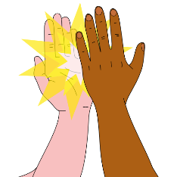
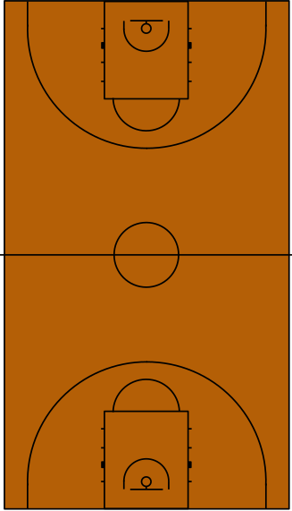
Basketball PE Challenge
Make up a game that will help other people to improve bouncing the ball.
How many times can you bounce the ball and catch it in 1 minute?
High-Five all the members of your family who completed the challenge!
Develop
Make up a game that will help other people to improve bouncing the ball.
What are the Rules of your game?
How does it help you improve?
How many different shapes can you find on the court?
Can you find a shape with 4 sides?
Can you find a curved shape?
Explore
Find any ball that bounces. How many different things can you do with the ball?
How many ways can you bounce the ball or move the ball around your body?
Bright ideas:
Bounce and catch with two hands.
- Bounce with one hand and catch with two hands.
- Bounce with one hand and catch with the other.

