Slide 1
WEST KIRBY PRIMARY SCHOOL
Year 6 Residential
2nd October 2024 – 4th October 2024

Slide 2
KS2 National Curriculum requirements.
To take part in outdoor activity challenges both individually and in a team.
Notes:
8

Slide 4
120 min.
70 min.
MANCHESTER
LIVERPOOL
30 min.
ANGLESEY
RUNCORN
NORTHWICH
CONWAY
CENTRE
LLANDUDNO
BANGOR
CHESTER
CREWE
CAERNARFON
HOLYHEAD
STOKE-ON-
TRENT
MENAI BRIDGE
Menai Straits
LLANFAIRPWLL
BANGOR
CONWAY
CENTRE
(Plas Newydd)
A 55
CAERNARFON

Slide 5
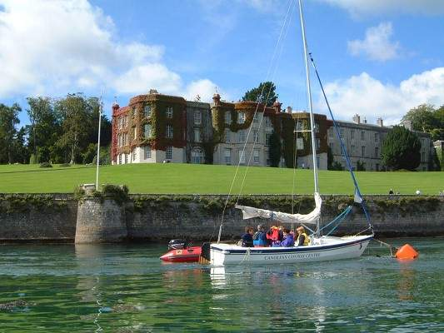

Slide 7
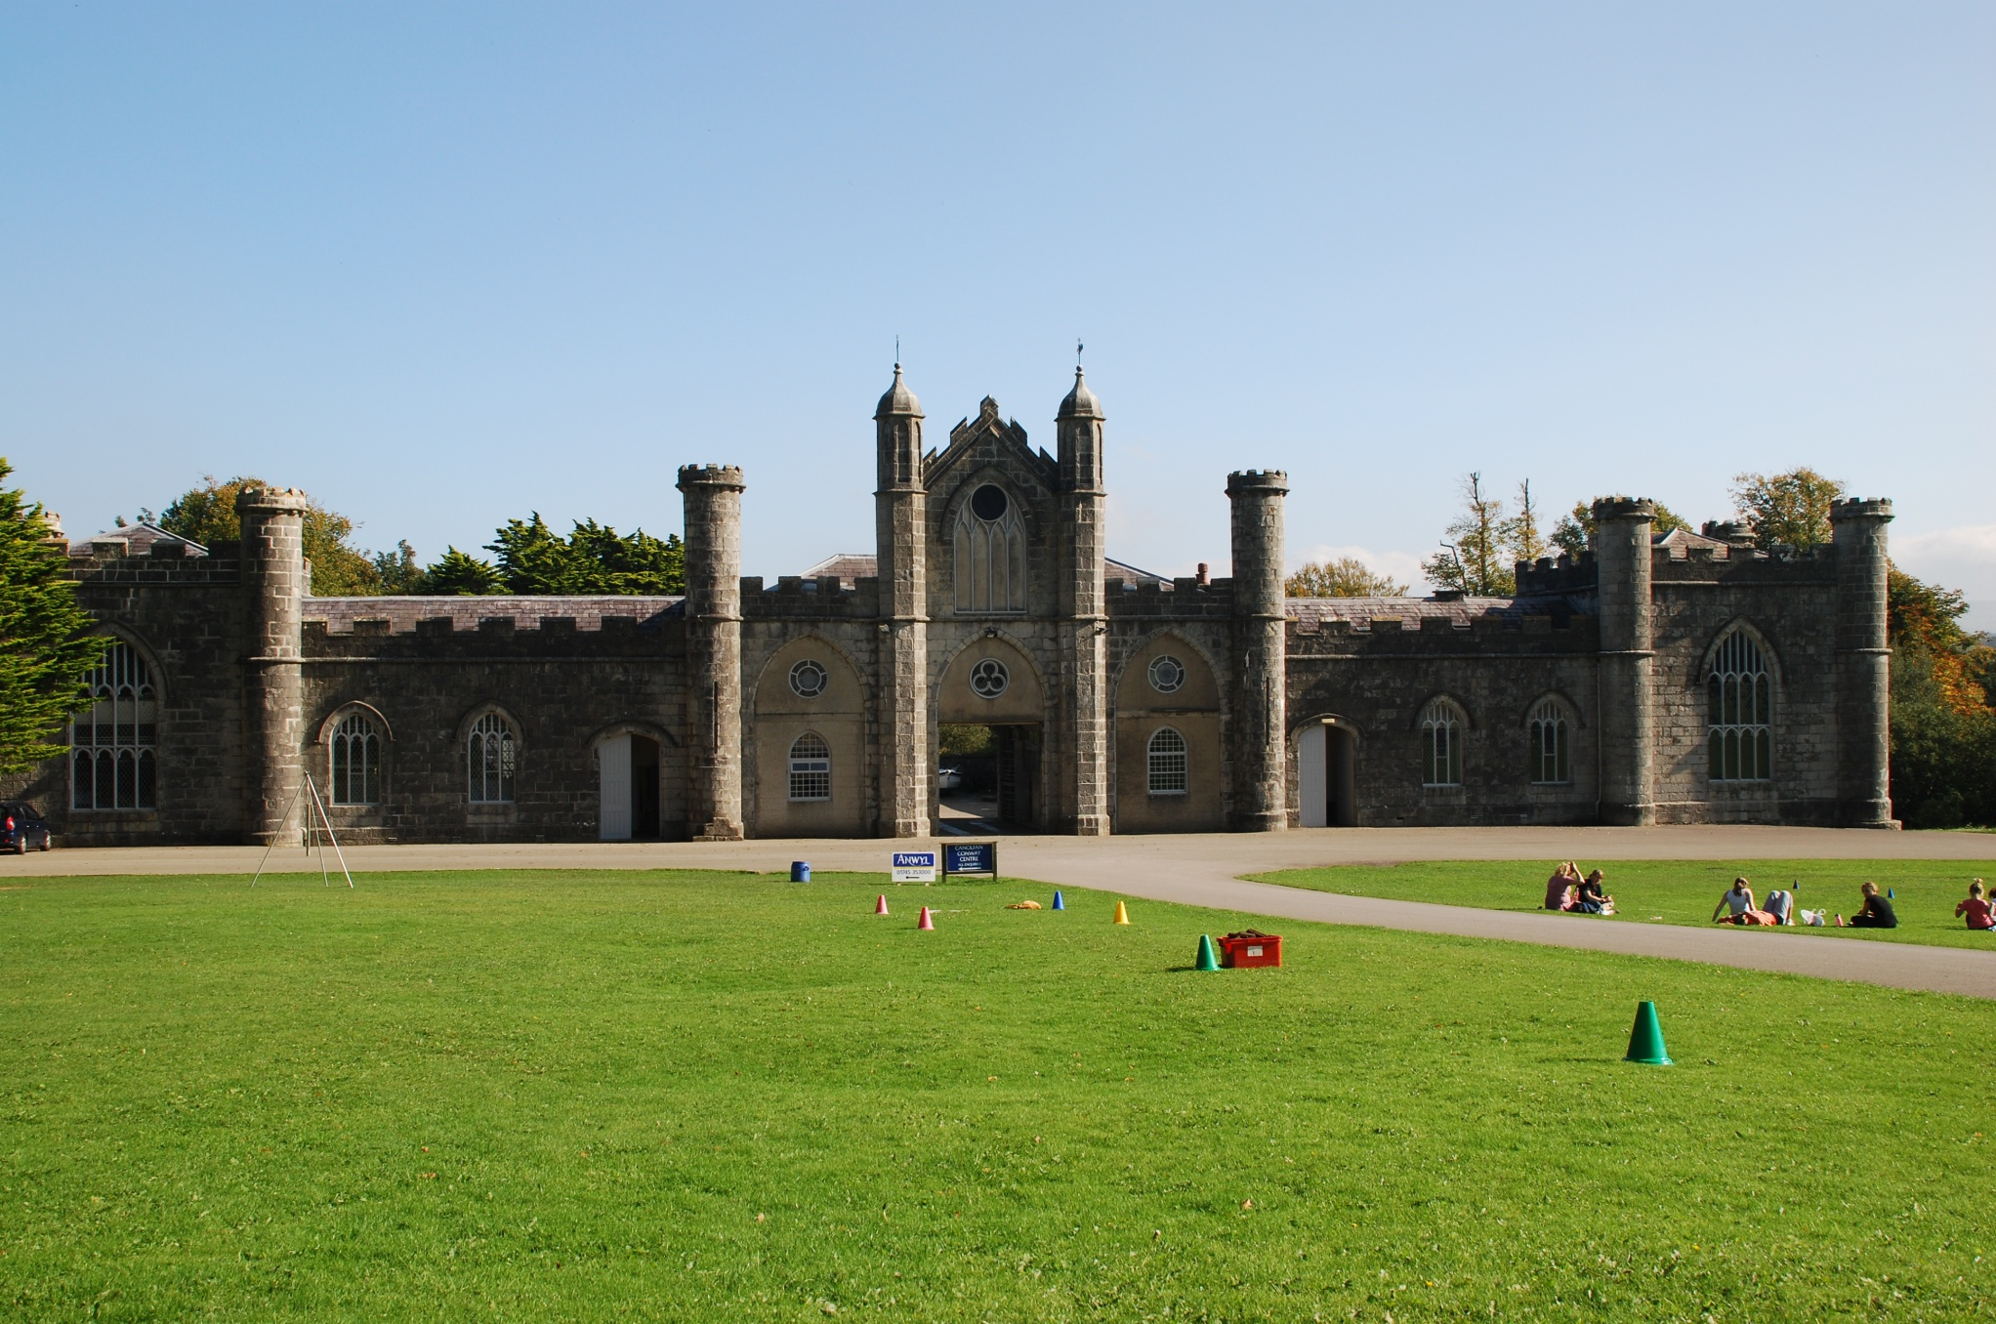

Slide 9
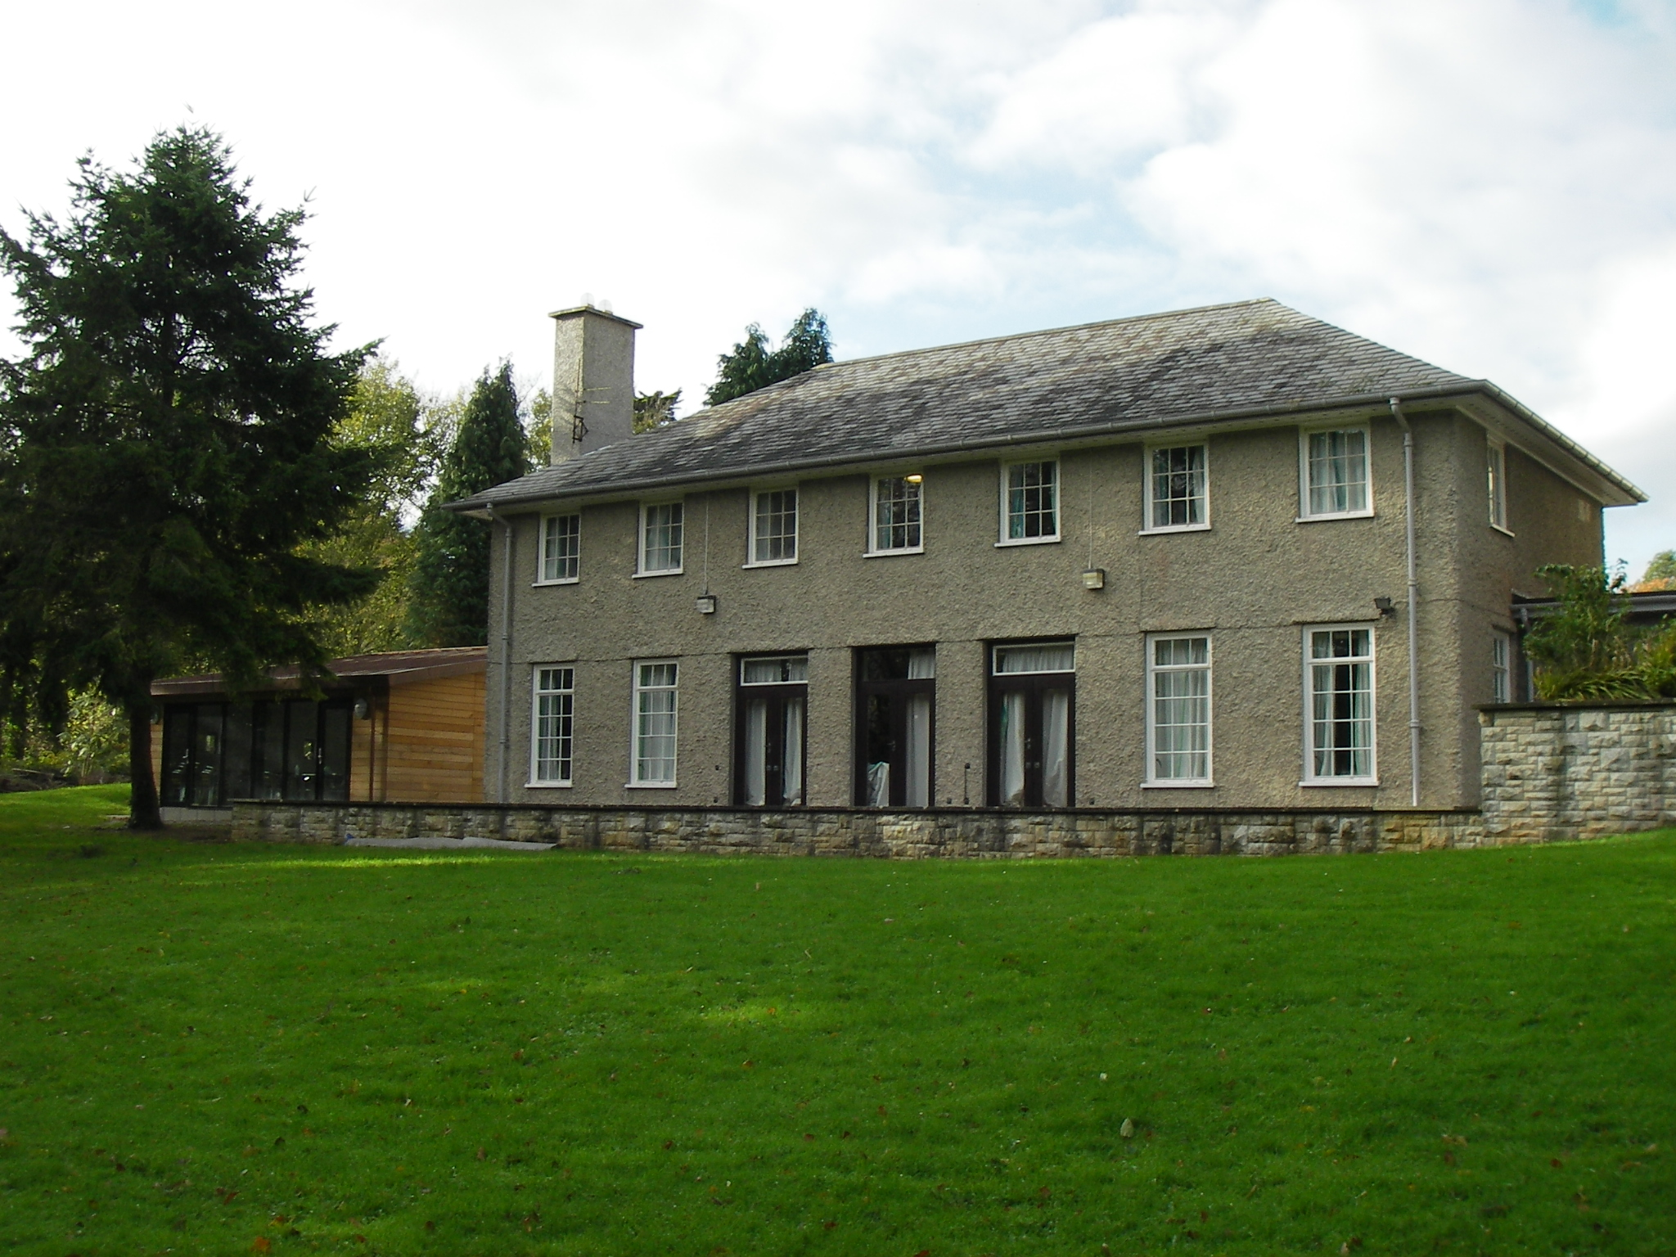

Slide 10
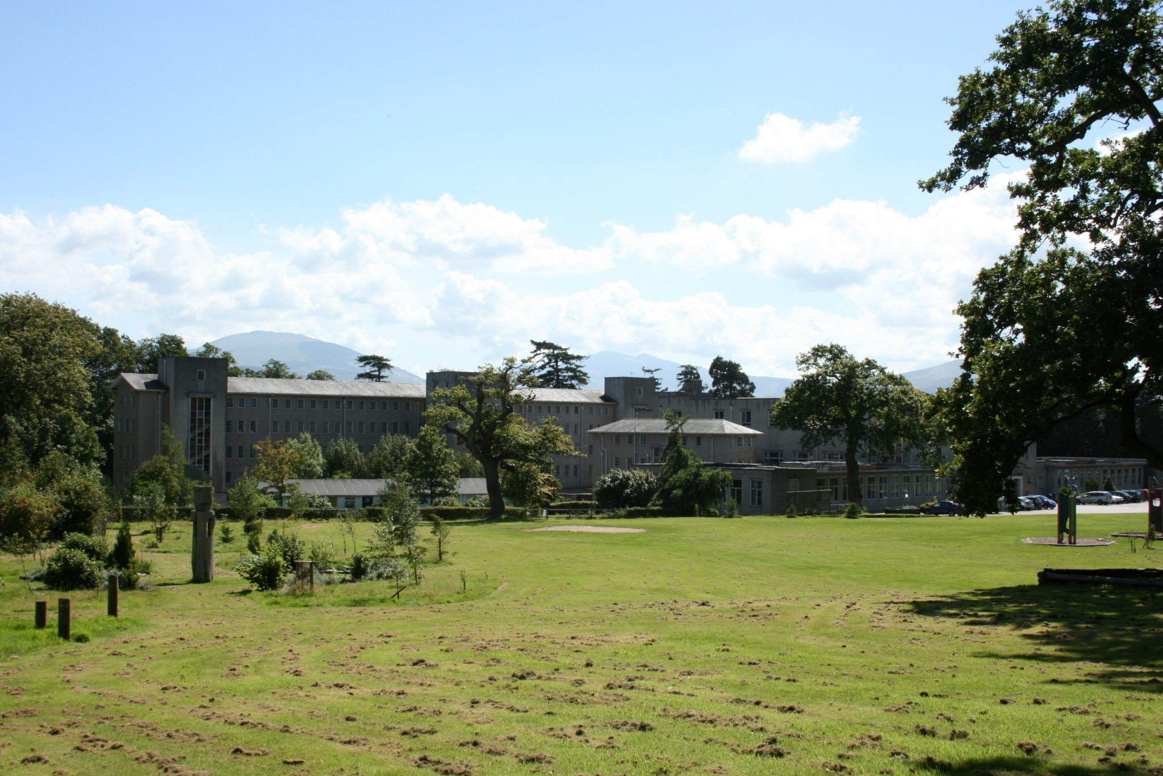

Slide 12
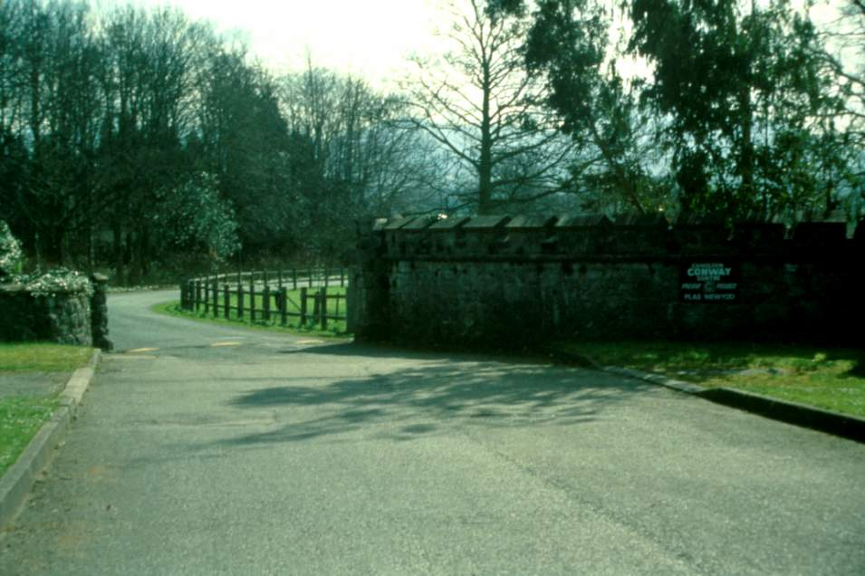

Slide 14
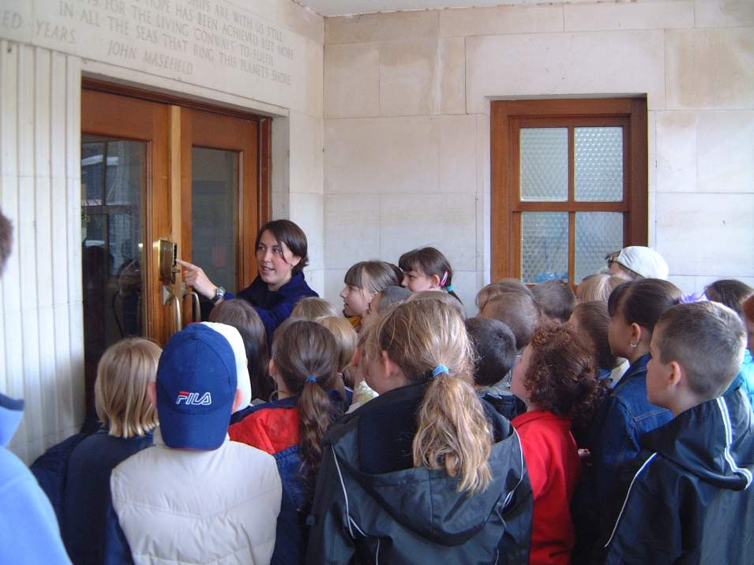

Slide 15
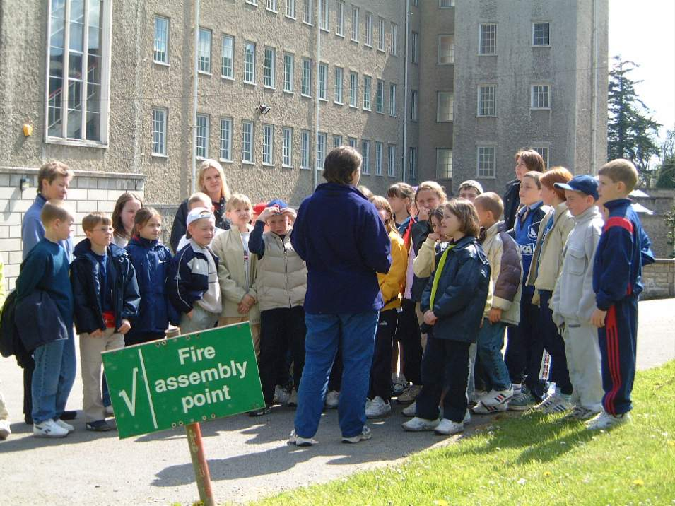

Slide 16
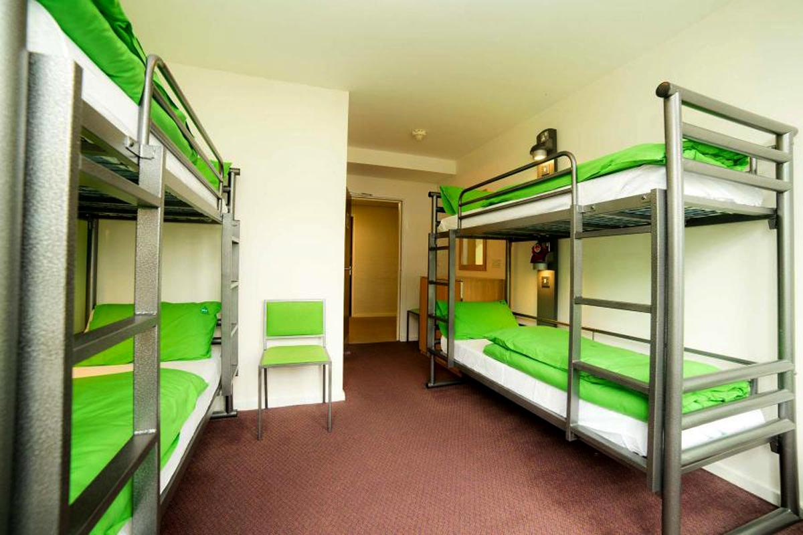

Slide 19
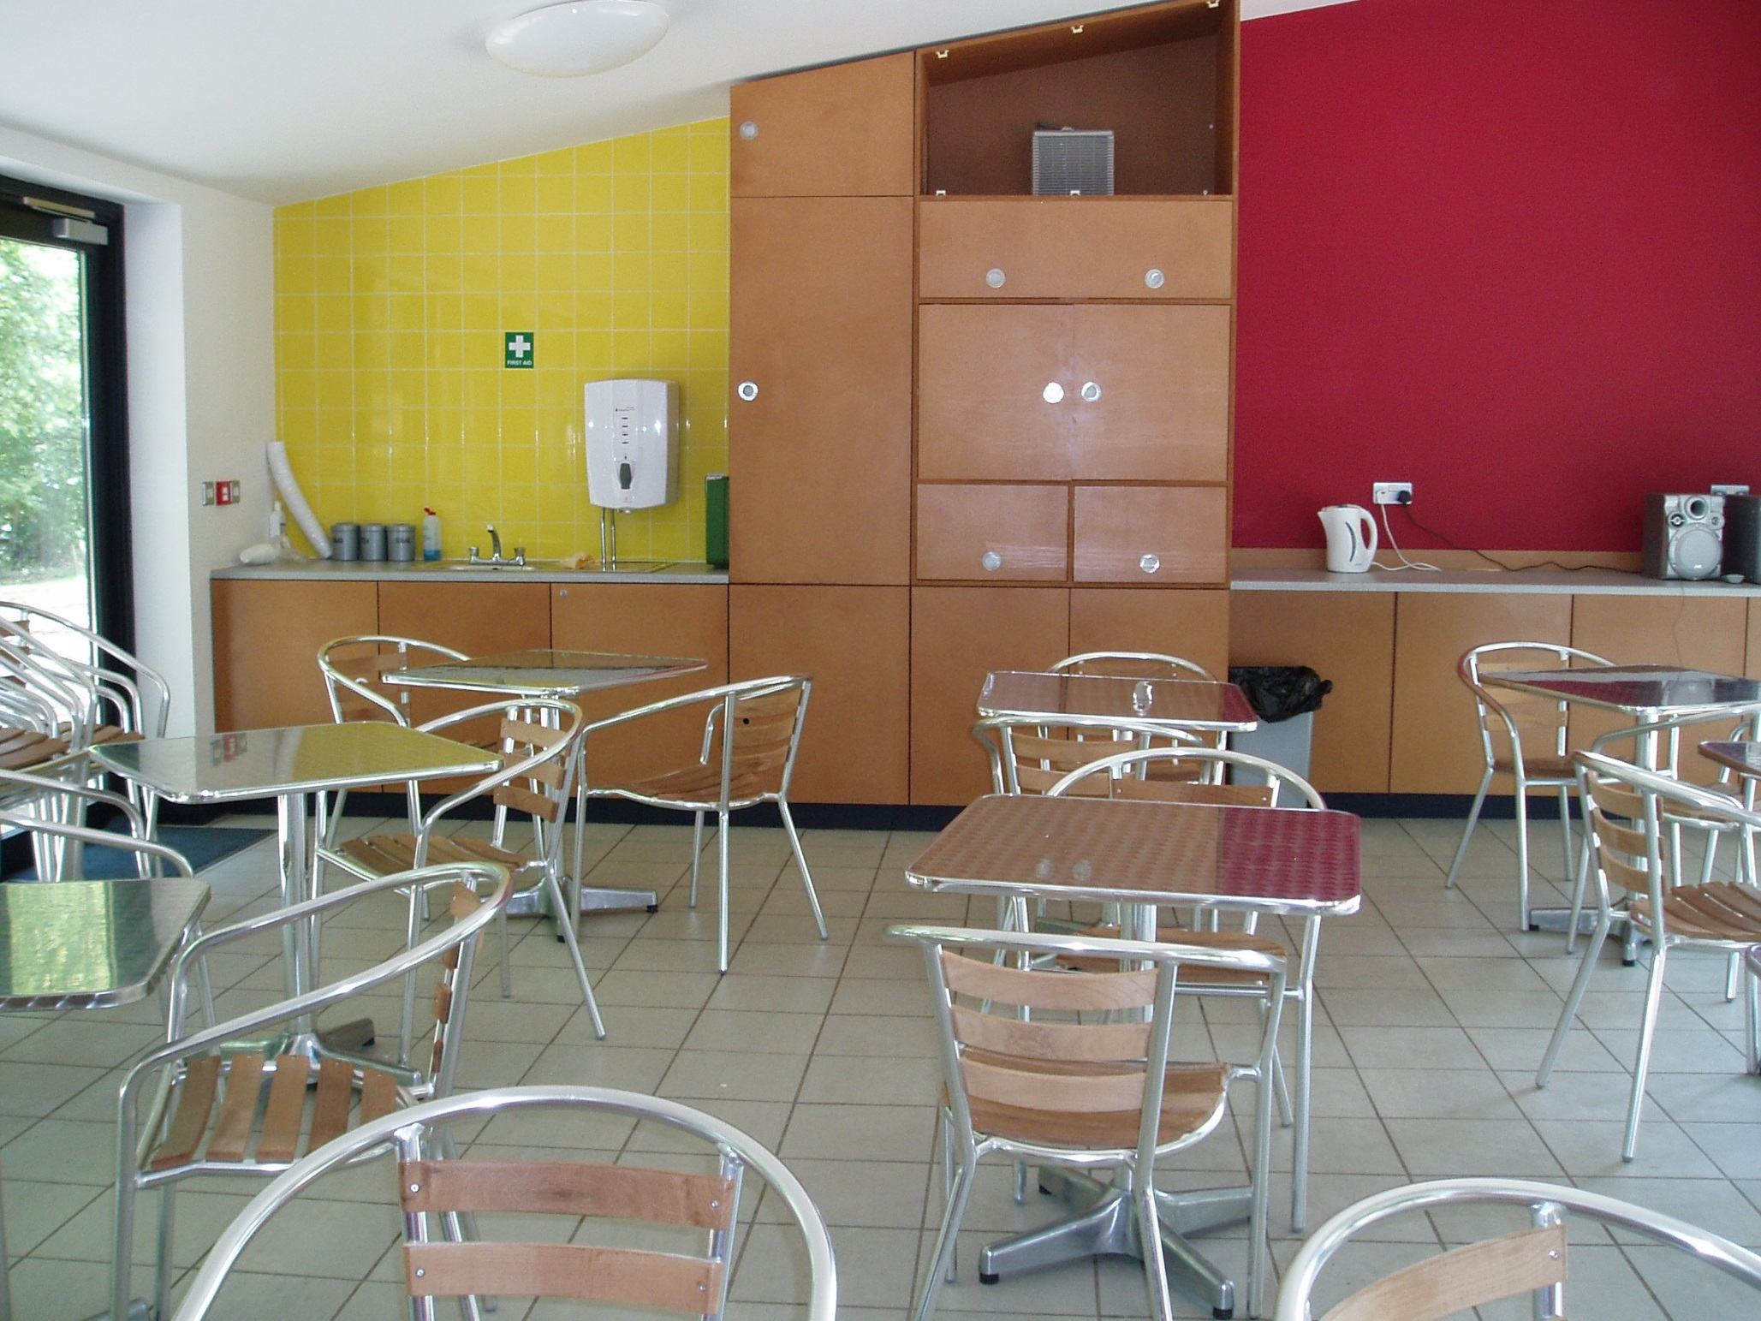

Slide 20
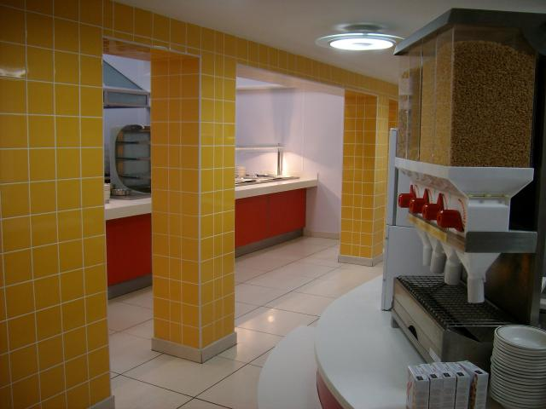

Slide 21
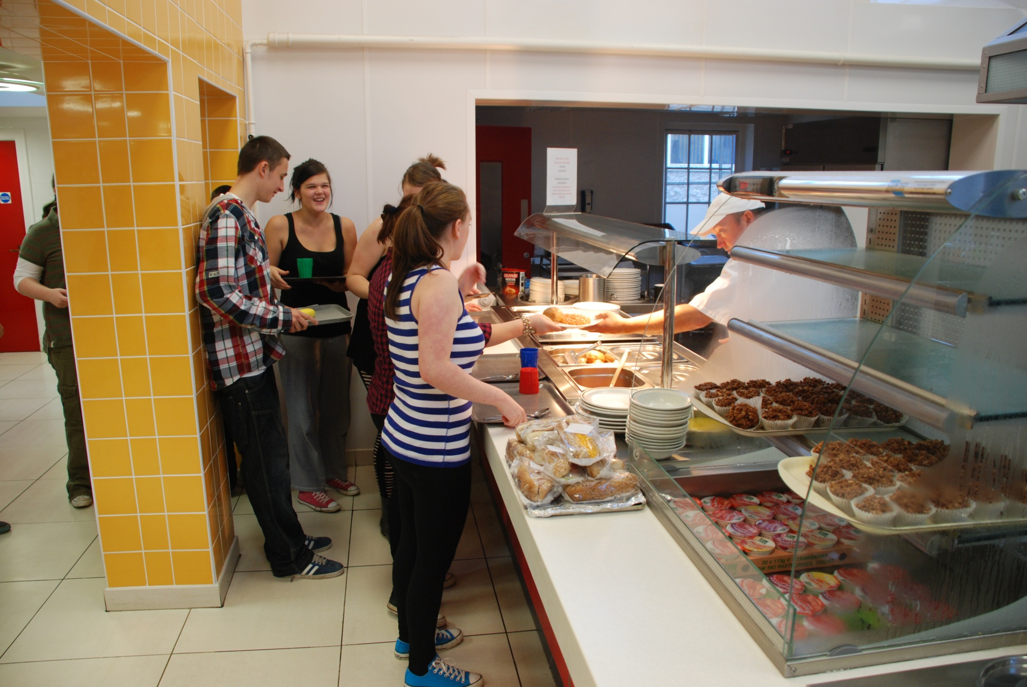

Slide 22
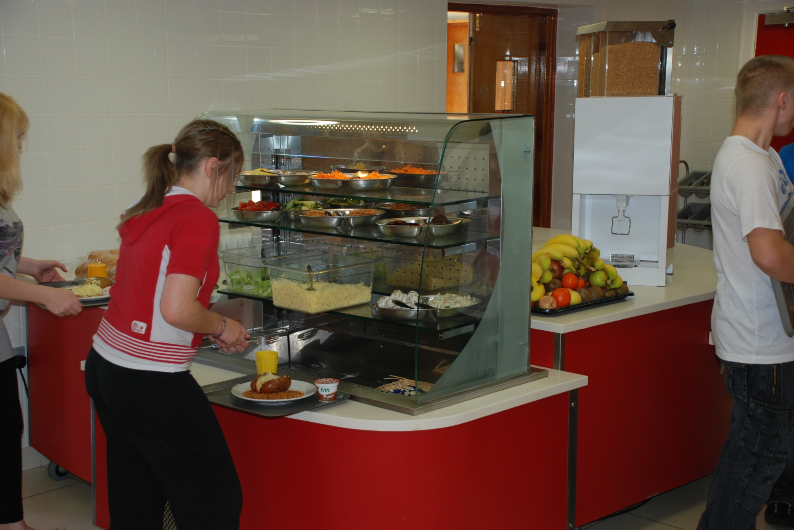

Slide 23
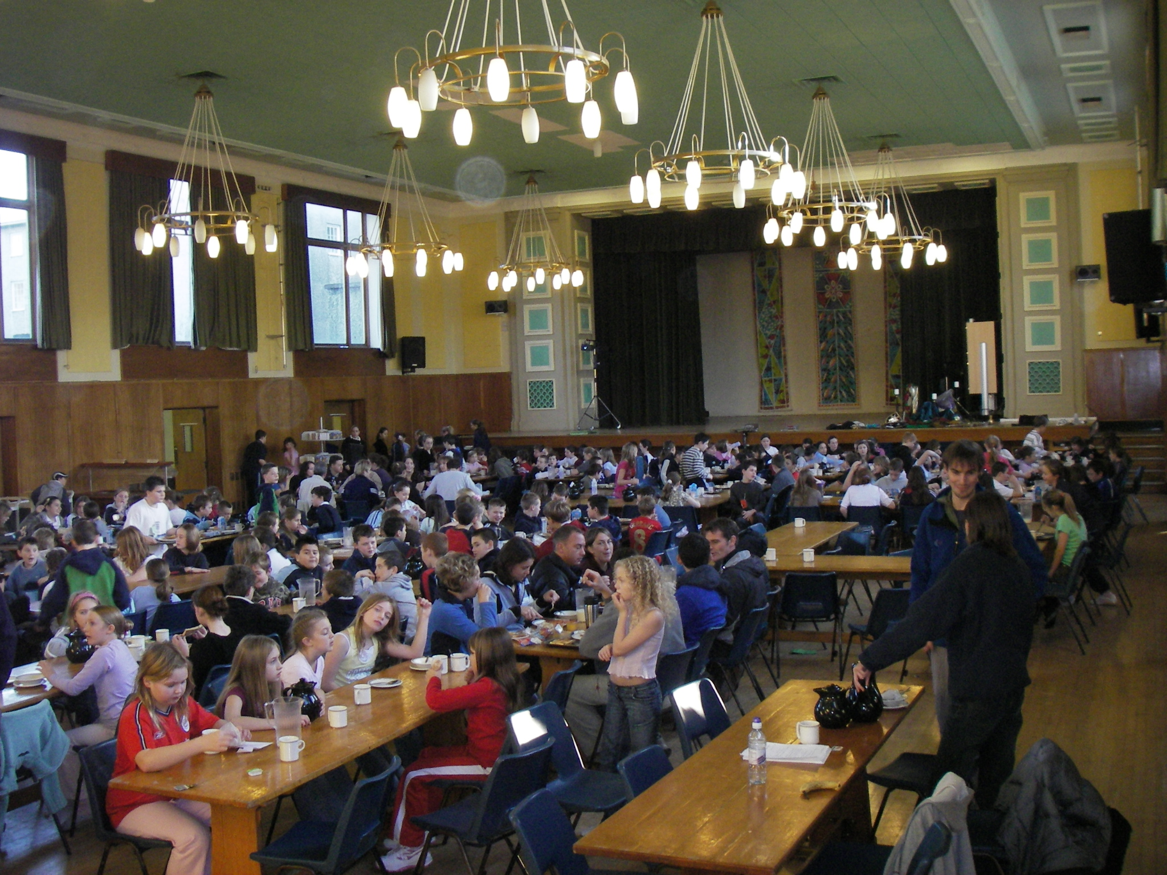

Slide 24
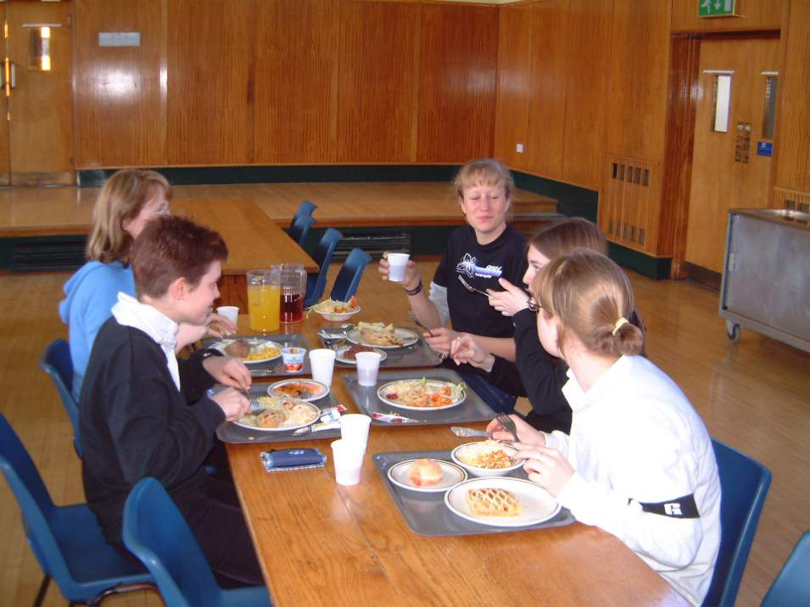

Slide 25
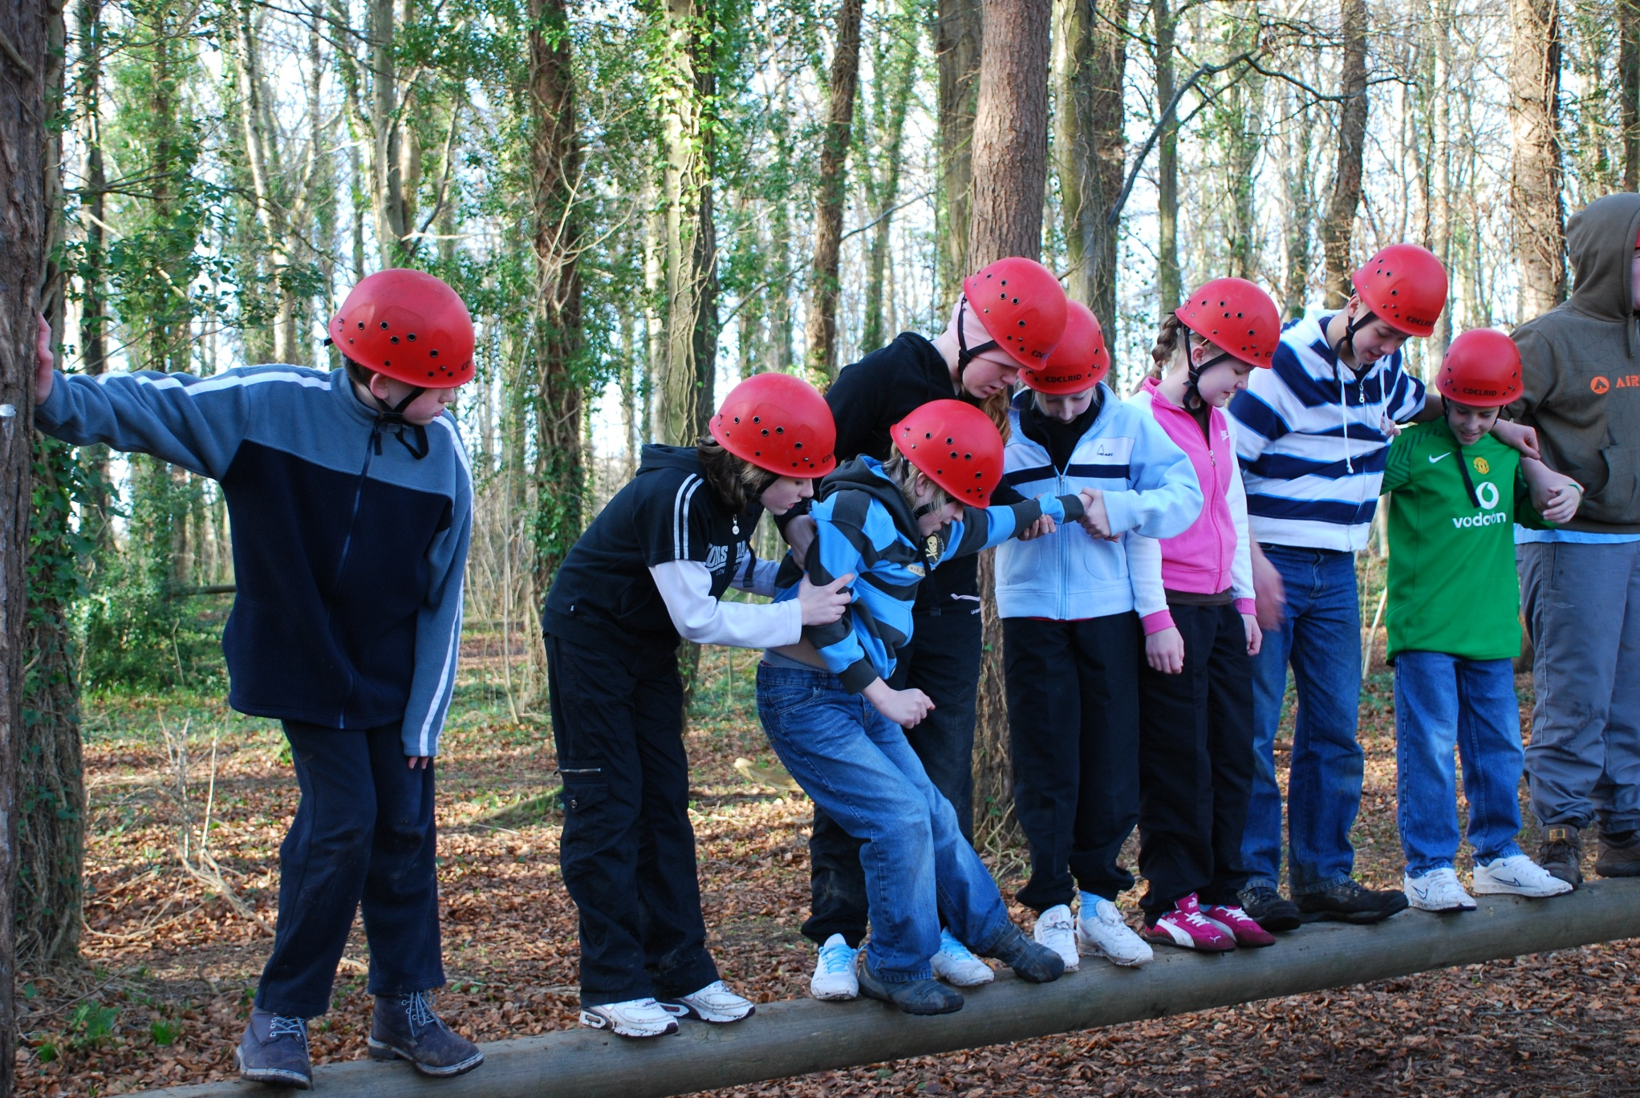

Slide 26
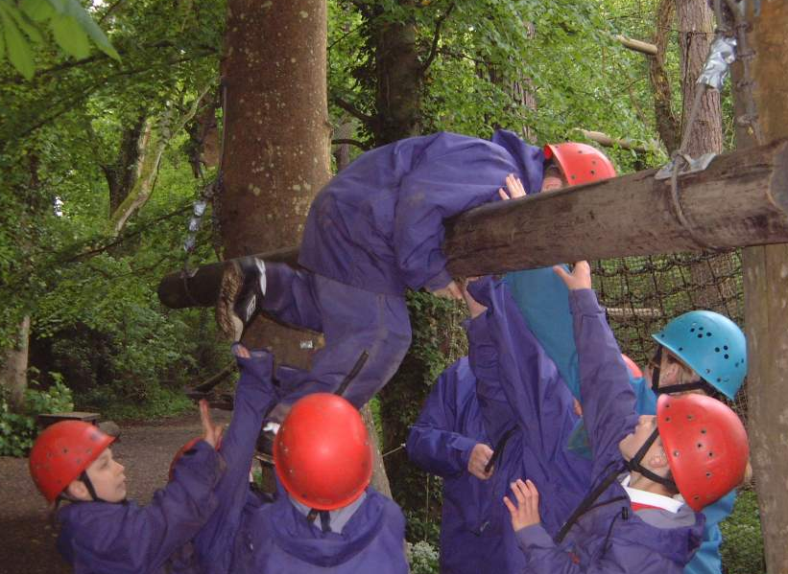

Slide 27
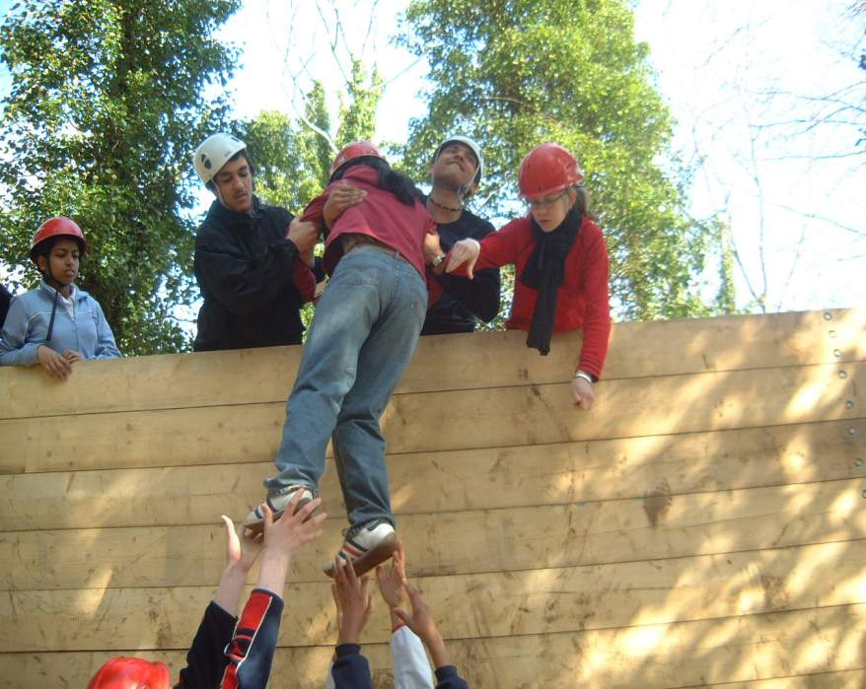

Slide 28
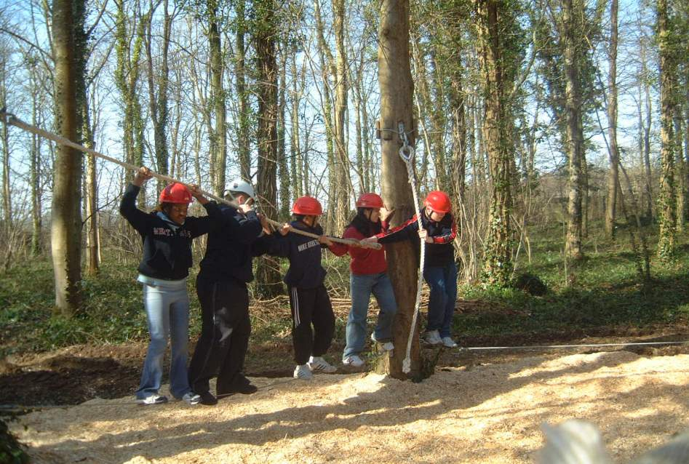

Slide 29
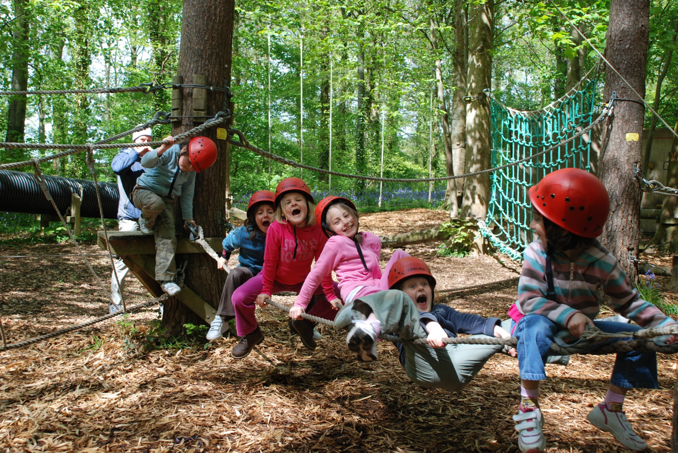

Slide 30
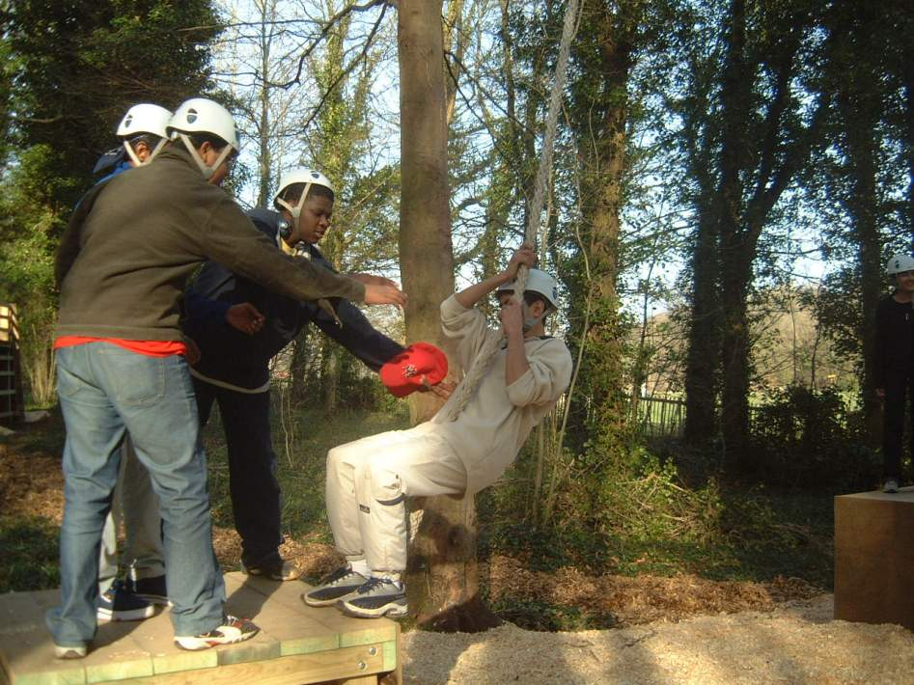

Slide 31
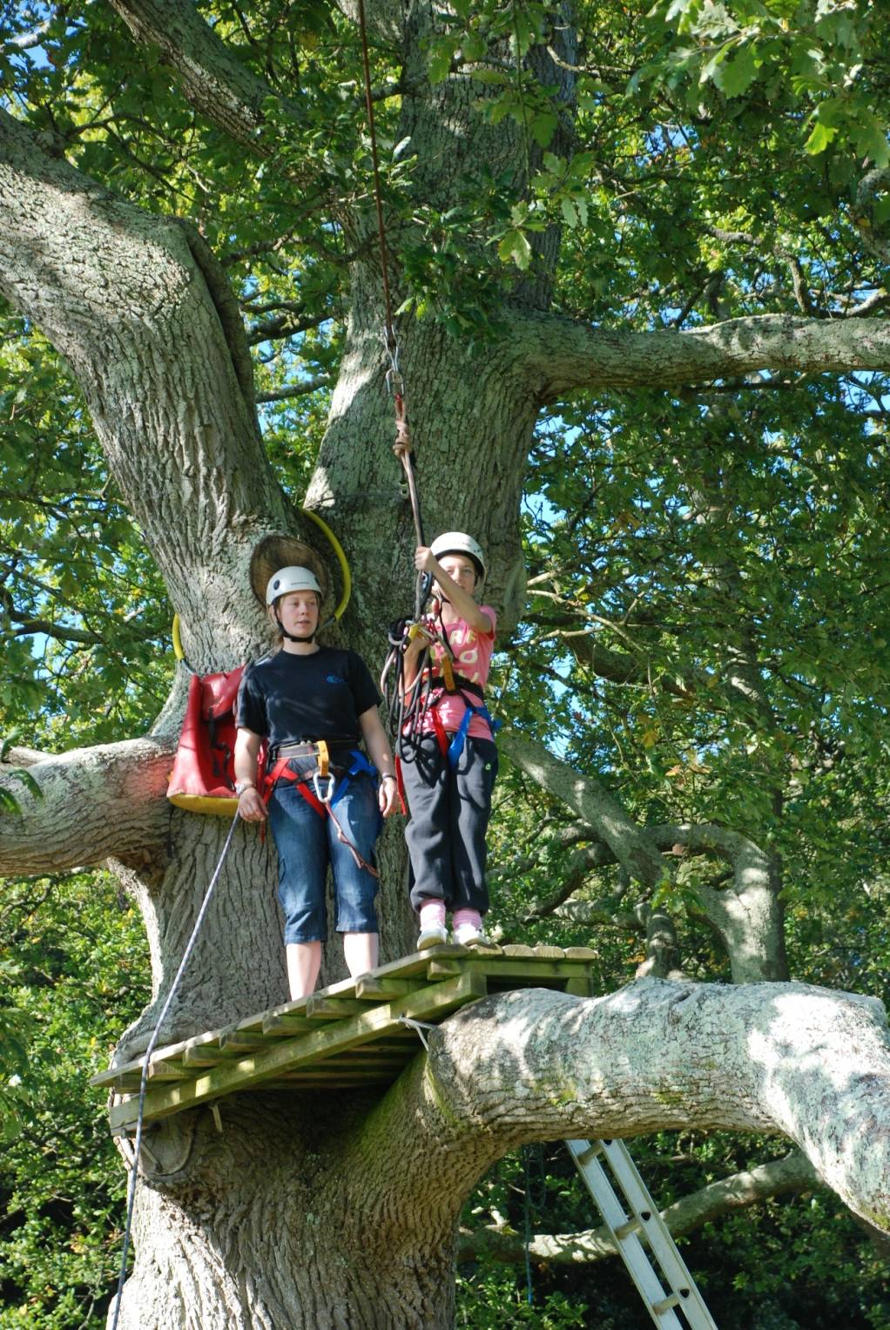

Slide 32
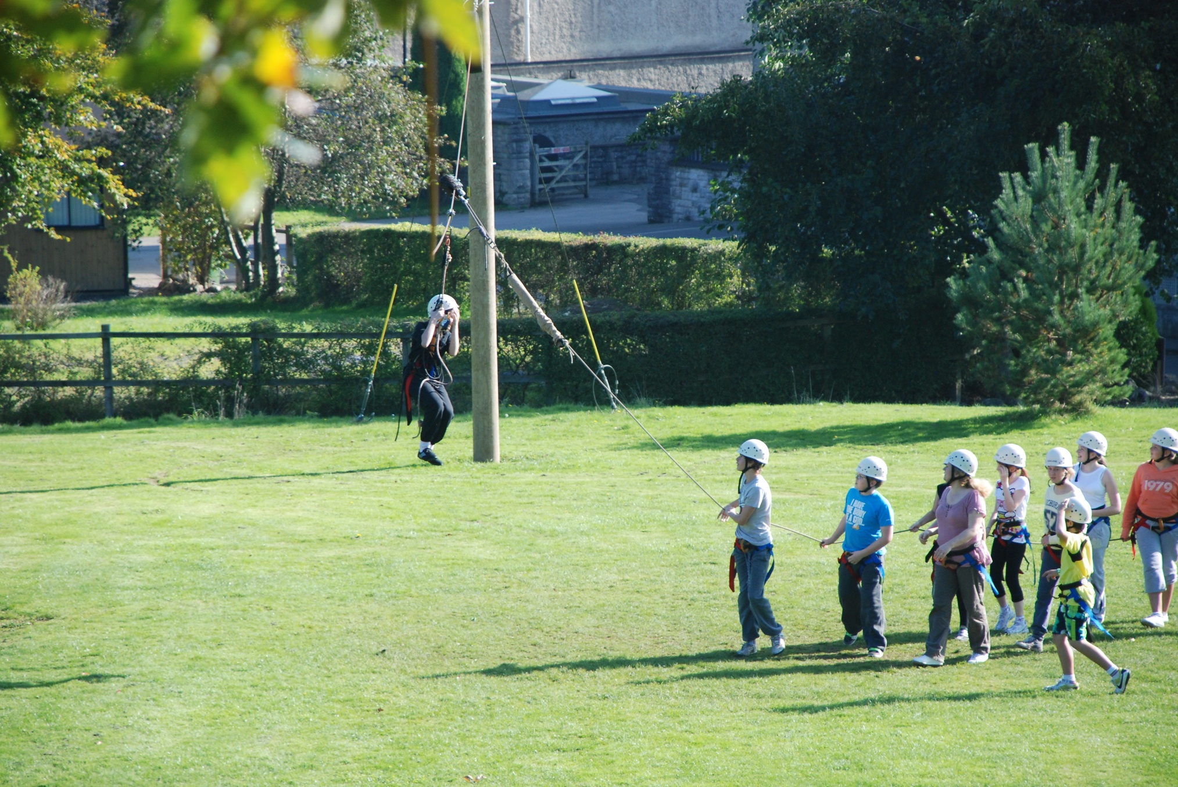

Slide 33
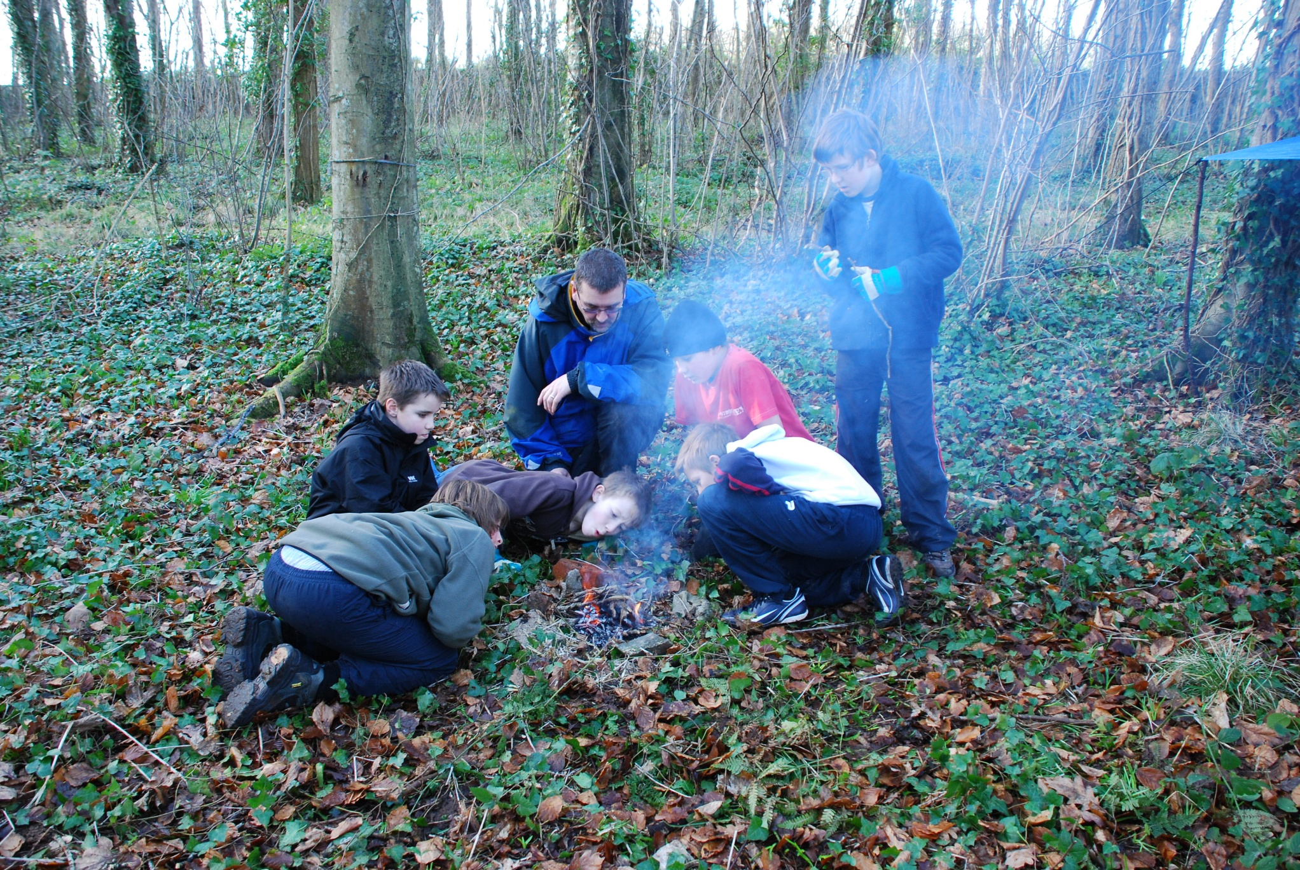

Slide 34
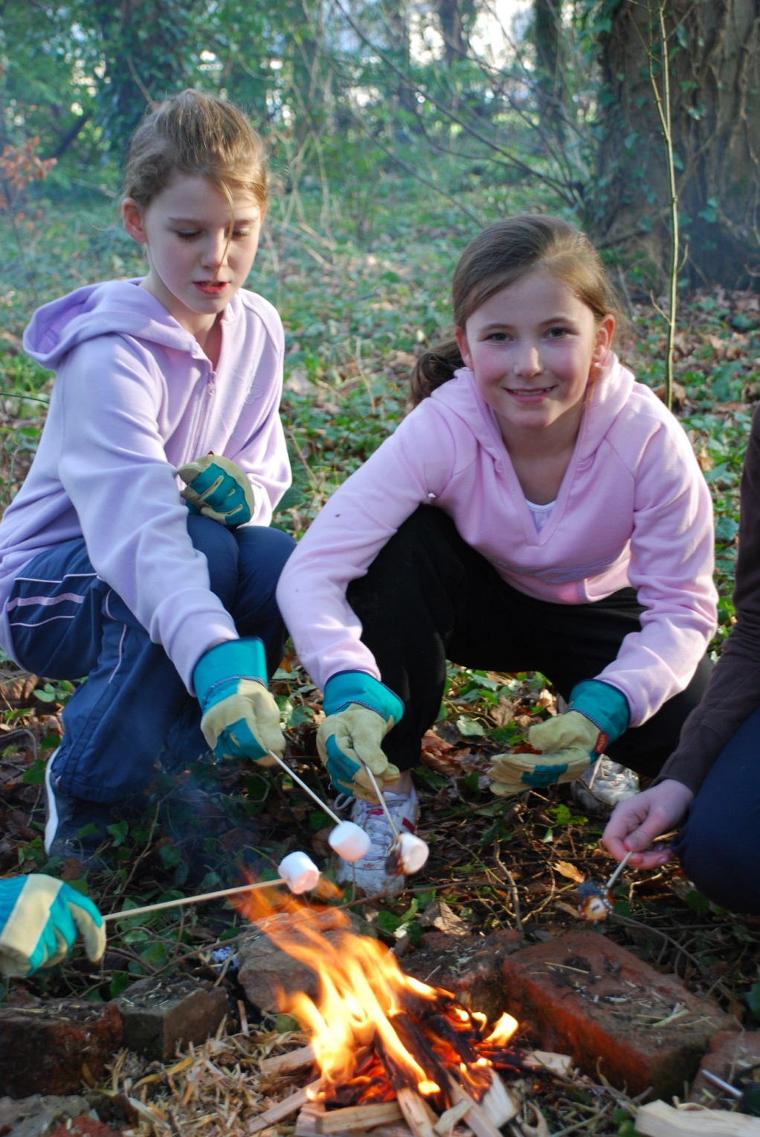

Slide 35
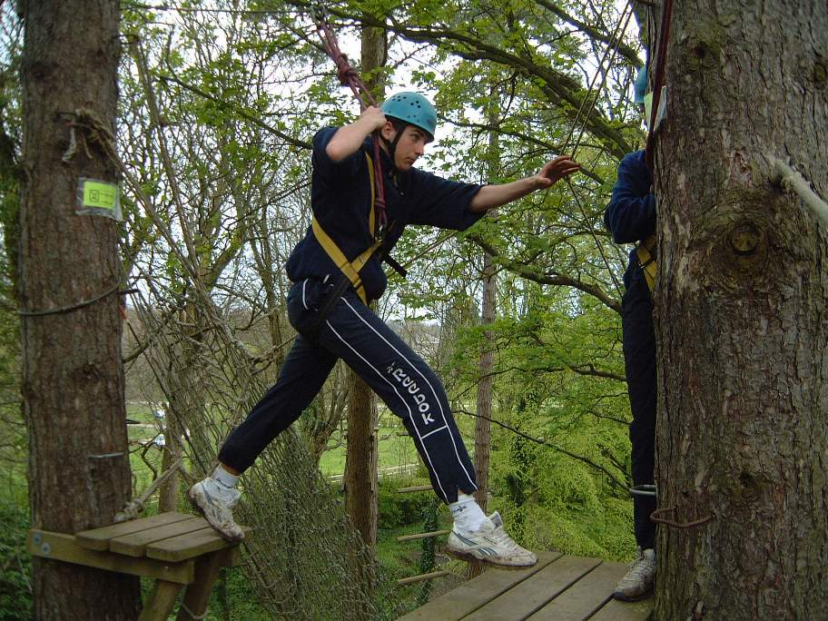

Slide 36
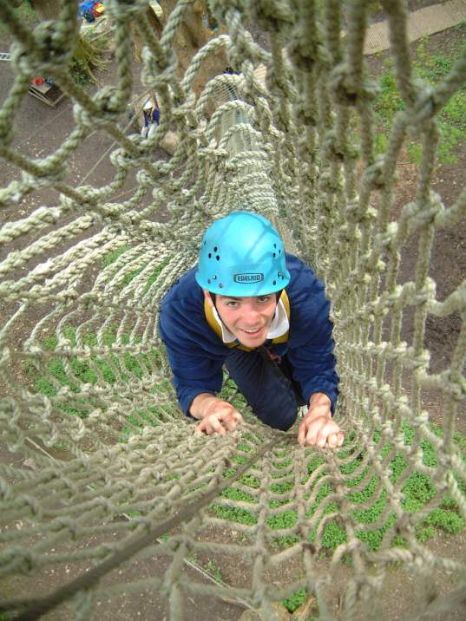

Slide 37
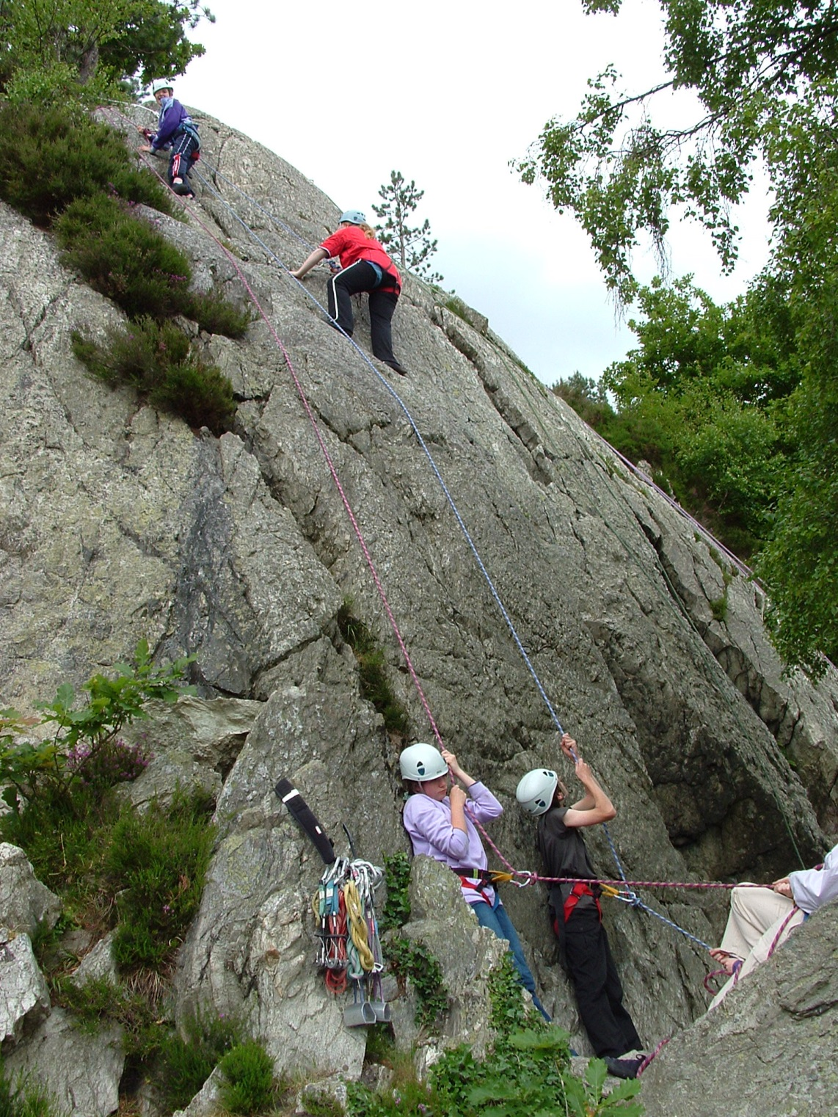

Slide 38
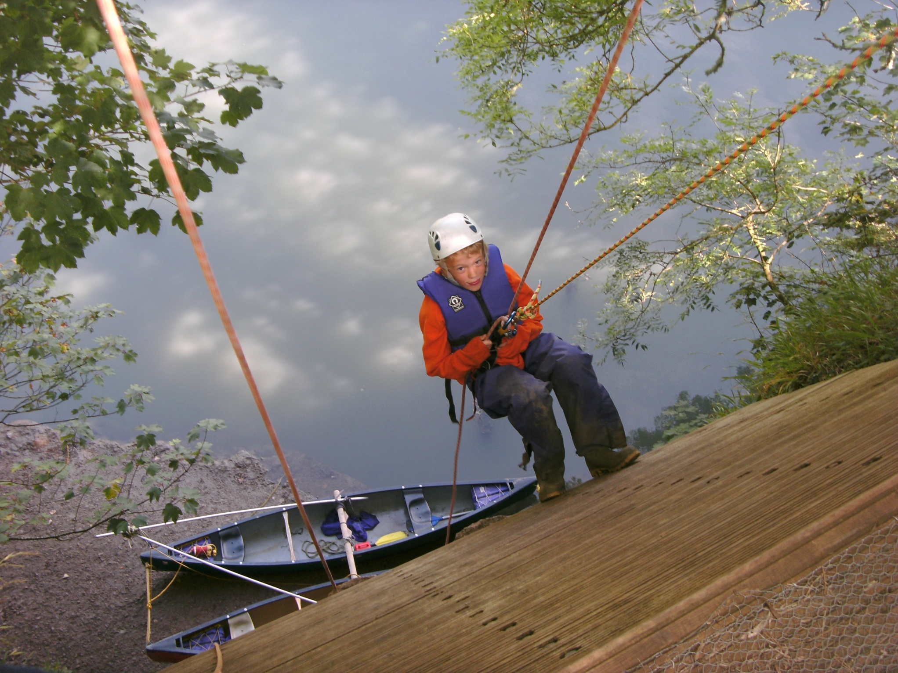

Slide 41
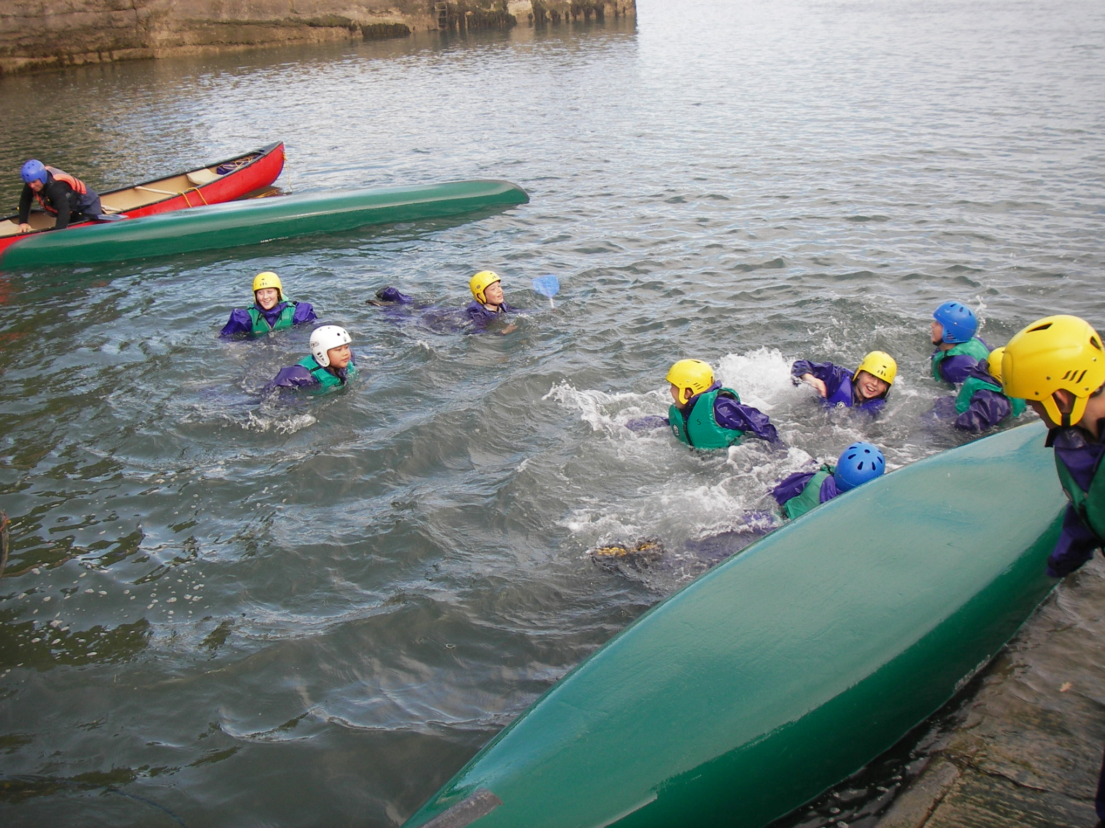

Slide 44
Panic Zone
Stretch Zone
Comfort
Zone
Our aim is to encourage young people to take a step outside of their normal comfort zone with our support and the help of the other members of the group.

Slide 45
Panic Zone
Stretch Zone
Comfort
Zone
By doing this in a safe and supportive learning environment, confidence, ability and self esteem will increase.

Slide 47
Residential October 2024 - £247 includes accommodation, transport, meals & snacks, activities and instructors and insurance.
Deposit of £25 required to be paid on Parent Pay by 24th November. We need to secure our booking and choice of activities.
Further instalments to be made through Parent Pay.
Notes:
The full cost will be £247 and if you are receipt of free school meals -£123.50. This covers the cost of accommodation, transport, meals, instructors, insurance.
If you intend for your child to go on the residential, you will need to secure their place with a deposit of £25
If we do not receive a deposit we will assume you do not wish your child to attend as we have to book numbers for attending the Residential with the Conway centre by 24th November.
We will set up to pay by instalments of Parent Pay. Unfortunately we can only stage 6 instalments but you can pay more than the instalment if you wish.
We are sharing this information with you now so that you know what it is you will be paying for and what you are signing your child up to do at the Centre.
.

Slide 48
www.conwaycentres.co.uk
Canolfan Conway Centre
Llanfairpwll
Anglesey LL61 6DJ
Email: admin@conwaycentre.co.uk

