Slide 1
EYFS Phonics Workshop
27/02/2021

Slide 2
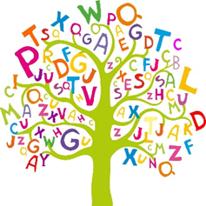
Did you know?
The English language has:
26 letters
44 sounds
Over 100 ways to spell those sounds.

Slide 3
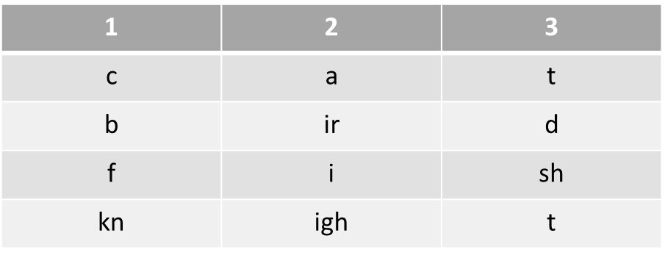
Vocabulary
Grapheme – a letter or sequence of letters that represent a phoneme (sound).
Phoneme – a sound in a word
Blending – putting all the sounds together
Segmenting – breaking down a word into its phonemes (sounds) for writing.
Digraph – two letters making one sound
Trigraph – three letters making one sound

Slide 4
What is phonics?
Phonics is a method for teaching reading and writing. We have structured daily lessons and activities in our provision.
Teaches the ability to hear, recognise and use the sounds within words.
Children will also be taught other skills, such as whole-word recognition (‘tricky words’), book skills, comprehension and a love and enjoyment of reading.

Slide 5
Listening skills
Phonics learning relies on children being able to hear and distinguish the sounds within words.
Listening skills begin at birth and these skills are developed during their early years.
The first phase of formal phonics education (Phase 1) also focuses on key listening skills.

Slide 6
Phase One Phase One has 7 aspects, with a focus on listening skills,
Environmental sounds
Instrumental sounds
Body Percussion
Rhythm and rhyme
Alliteration
Voice sounds
Oral blending and segmenting.
Notes:
Environmental sounds – sounds we hear around us every day; listening to and imitating sounds; how to be a good listener. Ideas – make sounds to copy, e.g. sh sh sh, zzzzzz, p-p-p-p; go on a ‘listening walk’ – what can you hear?; talk about how to be a good listener; sing songs that require repetition and response, e.g. ‘Old MacDonald’.
Instrumental sounds – listening to and discriminating the sounds made by different instruments. Ideas – make sounds with a range of different instruments (non-musical instruments such as pots, pans, home-made shakers will all do); play an echo game where children have to copy a rhythm; hide an instrument behind a box or screen and play it, children have to say which instrument you are playing.
Body percussion – using the body to create sounds and follow a song, rhyme or beat. Ideas – sing songs that require actions, such as ‘Wind the Bobbin Up’, ‘Heads, Shoulders, Knees and Toes’, ‘If You’re Happy and You Know It, Clap Your Hands’; pass a body percussion sound around a group, e.g. sit in a circle or opposite one another, take turns to produce a body percussion sound which is then passed on, e.g. tap on shoulders, clap hands, stamp feet.
Rhythm and rhyme – recognising rhythms and rhymes in songs, speech and nursery rhymes. Ideas – sing and chant rhyming songs; read stories with repetition and rhyme, e.g. ‘The Gingerbread Man’, ‘Each Peach Pear Plum’; play a matching game with pictures of rhyming objects, e.g. frog/dog, hat/cat, mouse/house; clap the rhythm of phrases and rhymes or the syllables in words or names; play ‘I Spy’ – ‘I spy, with my little eye, something that rhymes with….’ Example game on next slide.

Slide 7
Phase Two
In Phase 2, children begin to learn some letter sounds and to match them to graphemes.
Most of the first sounds are single-letter sounds but there are also several digraphs, where one sound is represented by two letters, e.g. ‘ck’, ‘ll’, ‘ss’.
Children also begin to blend the sounds to make words and segment them to learn how to spell.
Set 1: s, a, t, p Set 2: i, n, m, d Set 3: g, o, c, k Set 4: ck, e, u, r Set 5: h, b, f, ff, l, ll, ss

Slide 8
Blending
Building words from phonemes to read.
c a t
cat

Slide 9
Segmenting
Breaking down words for spelling.
cat
c a t

Slide 10
Phase Three
Children are taught another 25 graphemes.
The final single-letter sounds are taught, together with more consonant digraphs (e.g. zz, qu) and several vowel digraphs (e.g. ai, ee, igh).
Children also continue to learn how to blend and segment CVC words using the new sounds, e.g. tail, sheet, night – note that these words still only have three sounds.
Set 6: j, v, w, x
Set 7: y, z, zz, qu
Consonant digraphs: ch, sh, th, ng
Vowel digraphs: ai, ee, igh, oa, oo, ar, or, ur, ow, oi, ear, air, ure, er

Slide 11
Phase Four onwards
Phase 4 consolidates all that the children have learnt in the previous phases.
In Phase 5 children will be taught new graphemes and alternative pronunciations for these graphemes. This typically begins in Year 1.
In Phase 6 the focus is on learning spelling rules for suffixes (word endings). This typically begins in Year 2.

Slide 12
Phonics lessons
Children are taught phonics daily throughout the week and follows the format: Revisit/review, Teach, Practise, Apply.
The activities used to teach will vary and can be adapted to suit the children's needs.

Slide 13
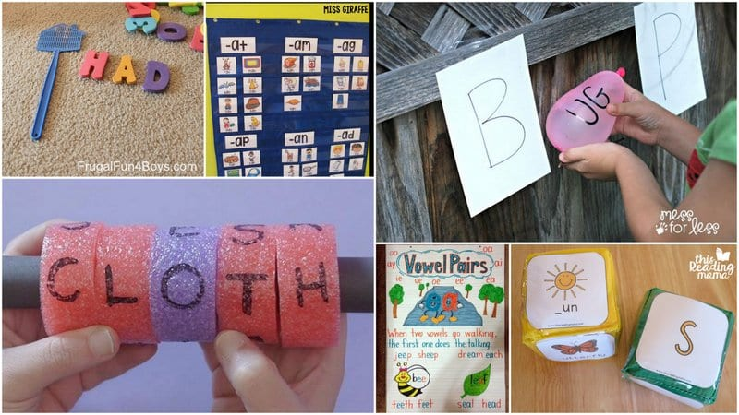
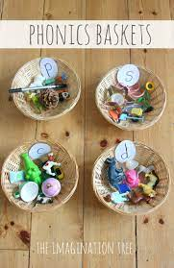
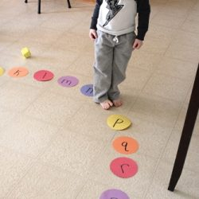
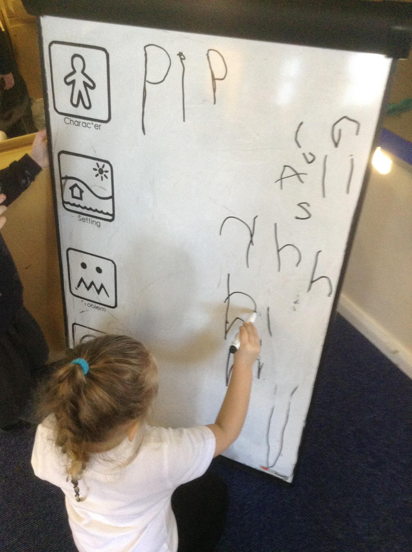

Slide 14
Book bags
Book bags brought in on a Monday and go home on a Wednesday.
F2
Phoneme keyring
Reading book
Reading record
Tricky words
Library book
F1
EYFS F1 Library Book
Reading record

Slide 15
How to read your school book (F2)
Wordless books - Initially, they will be given picture books (with no words) for you to talk together about what is happening on each page.
Phonetically Decodable Books - Your child’s reading book will link to their phonic knowledge and will give them the opportunity to practice the phonemes/sounds they have been taught in school.
Spend about 5-10 minutes only. At first you may only read 1 or 2 pages at a time. Little and often is more beneficial than one longer session. Try to keep it light and fun!

Slide 16
How to read your school book (F2)
Before Reading -
What can they see?
What is happening on each page?
Can they think of a similar experience they’ve had?
Can they predict/guess what might happen next based on what has been seen so far.
Whilst Reading - Encourage your child to use their finger to point to each letter sound as they blend the sounds to read the word. Talk about the meaning of what they have read at the end of the sentence.
After Reading
Discuss what happened in the story. Can they:
Give you a verbal summery about what happened?
Explain their opinions or express their feelings about certain parts?
What could happen next to the characters?

Slide 17
Reading for pleasure
The most important part of learning to read is recognising the joy a good book can bring! Whether it is a story or non-fiction book, reading together fosters imagination, develops relationships, improves emotional regulation and communication. In order to foster this enjoyment of books and reading we recommend sharing a bedtime story as part of your everyday routine. As much as you are able! This could be their school library book, or any favourite book from home.

Slide 18
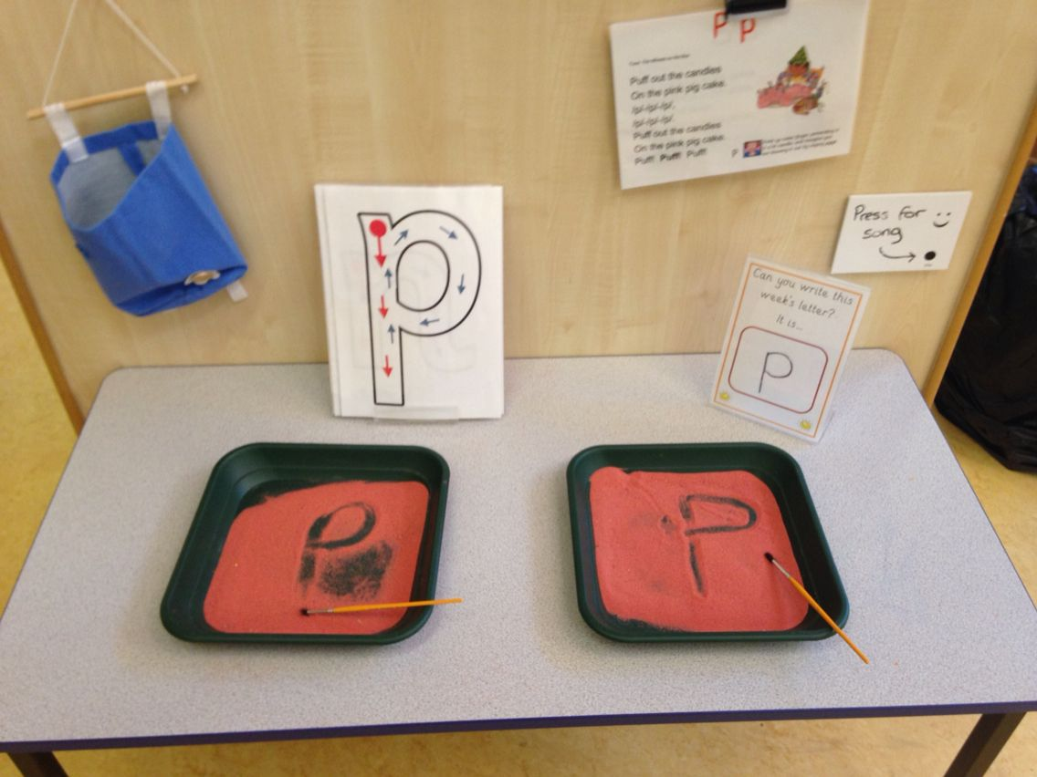
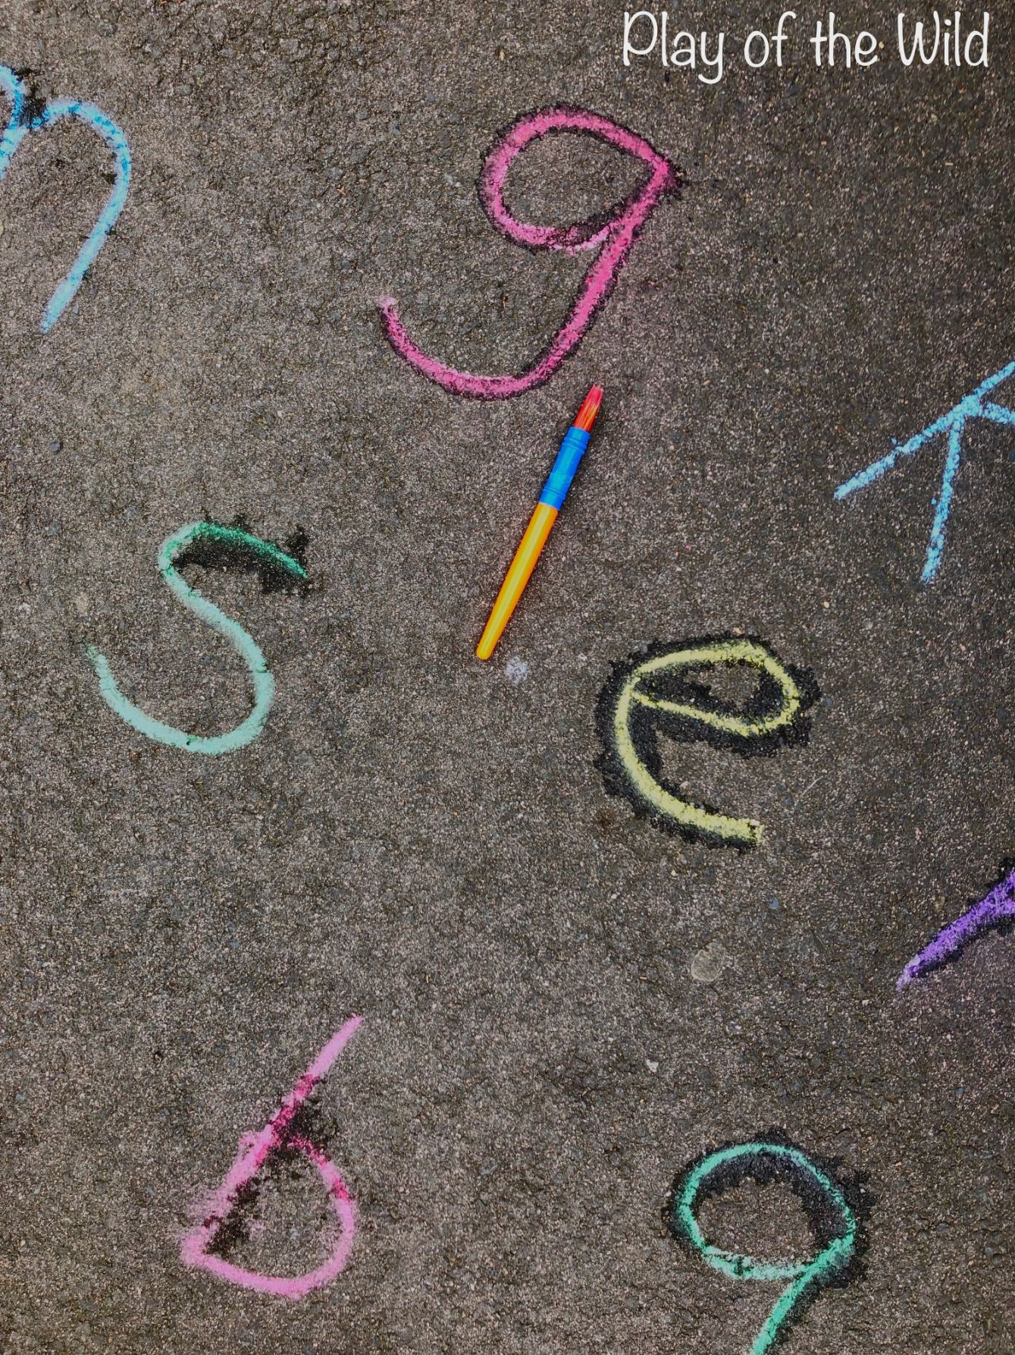
Phonics at home Suggested activities to support reading and phonics, can be found on our school website www.westkirbyprimaryschool.co.uk Click on the ‘Home Learning’ tab, select ‘Foundation Stage’ from the menu and open the ‘F2 Home Learning Autumn 1 2021’ PDF.
Listening games – sound hunt, listening walks, guess the sound.
Nursery rhymes and action songs.
I spy.
Silly soup.
Robby the robot.
Letter hunt.
Letter formation - everywhere in anyway!

Slide 19
Useful sites
https://www.youtube.com/watch?v=UCI2mu7URBc – how to pronounce ‘pure’ sounds
www.phonicsplay.co.uk - Select your child's phase. Some games are free others require registration.
http://www.letters-and-sounds.com - Select your child's phase and choose games.
https://www.teachyourmonstertoread.com/

