Slide 1
‘Welcoming your children to Upper Key Stage 2’

Slide 2
Objectives
Upper Key Stage Two Teaching Team
Structure of the school day
Reading, Writing and Maths
Handwriting
Spelling
Upper Key Stage 2 Topics
Website, Home Learning
PE & Swimming
Rewards and Sanctions
Keeping in Contact

Slide 3
Teaching Team in Upper Key Stage Two
Kingfisher Class
Year 5
Mrs Burrows)
Mrs Trenholm
(Teaching Assistant)
Egret Class
Year 5 & 6
Mrs Coombes (Mon)
Mrs Rogers Tue - Fri
(Class Teacher)
Cormorant Class
Year 6
Mrs McCann &
Mrs Sadler
(Class Teachers)
Mrs Gilbert
(Teaching Assistant)
Notes:
Donna, Claire, Dani

Slide 4
Structure of the School Day…
8:30am: School Starts (Register & Morning Challenge)
9:30am: Upper Key Stage Two Playtime
Lunch times:
Cormorant Class: 11:30am
Egret Class: 11:40am
Kingfisher Class: 1:50am
2:30pm: Home Time
Notes:
Donna

Slide 5
Personal belongings
All personal belongings that come into school should be clearly labelled.
Due to Covid-19 restrictions, children are only required to bring:
A waterproof coat
A water bottle
A lunch box (all children will need a packed lunch during the first few weeks of the autumn term due to kitchen works)
Book bags (Wednesdays only)
Please do not bring any other bags.
Notes:
Donna

Slide 6
UKS2 Expectations for Writing, Reading and Maths
These are end of year expectations to be Age Related
Notes:
Donna

Slide 7
Expectations in English - writing
Handwriting needs to be legible and show the ability to join clearly. To gain Greater Depth in National Curriculum Tests at Y6, the writing must be joined.
https://www.gov.uk/government/publications/national-curriculum-in-england-english-programmes-of-study/national-curriculum-in-england-english-programmes-of-study#upper-key-stage-2--years-5-and-6
Spellings on the Year 5/6 list contain some rather tricky spellings. A copy is on our website. Spelling need to be mostly correct in creative and free writing.
Learn their weekly spellings.
https://assets.publishing.service.gov.uk/government/uploads/system/uploads/attachment_data/file/239784/English_Appendix_1_-_Spelling.pdf

Slide 8
Expectations in English - writing
Punctuation showing use of commas to clarify meaning, hyphens, brackets, dashes or commas to indicate parenthesis, semicolons, colons and bullet points.
Grammar & Vocab showing formal and informal speech and writing, including subjunctive forms, various verb tenses, expanded noun phrases to convey complicated information concisely, modal verbs or adverbs, relative clauses beginning with who, which, where, when, whose, that or with an implied and relative pronouns.
https://assets.publishing.service.gov.uk/government/uploads/system/uploads/attachment_data/file/335190/English_Appendix_2_-_Vocabulary_grammar_and_punctuation.pdf

Slide 9
Expectations in English - reading
Read every day, doesn't have to be a book, could be a newspaper of magazine.
Be able to apply their growing knowledge of root words, prefixes and suffixes
Read aloud and understand the meaning of new words that they meet
Express their opinion on what they have read, discuss character and plot development.
https://www.gov.uk/government/publications/national-curriculum-in-england-english-programmes-of-study/national-curriculum-in-england-english-programmes-of-study#upper-key-stage-2--years-5-and-6

Slide 10
Expectations in Maths
Every child by the time they leave Year 4 is expected to know all of their times tables up to 12 x 12.
In UKS2 knowing your times tables is a non-negotiable as so much of our maths curriculum relies on children having a secure knowledge and quick recall of these number facts.
Complete their Mathletics tasks each week.
https://www.gov.uk/government/publications/national-curriculum-in-england-mathematics-programmes-of-study/national-curriculum-in-england-mathematics-programmes-of-study#year-5-programme-of-study
https://www.gov.uk/government/publications/national-curriculum-in-england-mathematics-programmes-of-study/national-curriculum-in-england-mathematics-programmes-of-study#year-6-programme-of-study

Slide 11
‘Topic Webs , Home Learning & Learning Mats’
-working in partnership with you to ensure that all of our pupils enjoy learning and are curious.

Slide 12
Navigating our Website
Since September 2014, we have been posting all of our Topic Webs & Home Learning tasks on our school website. At the beginning of each half term, you can see a copy of the Topic Web for UKS2. From the Home page click the ‘Curriculum’ tab

Slide 13
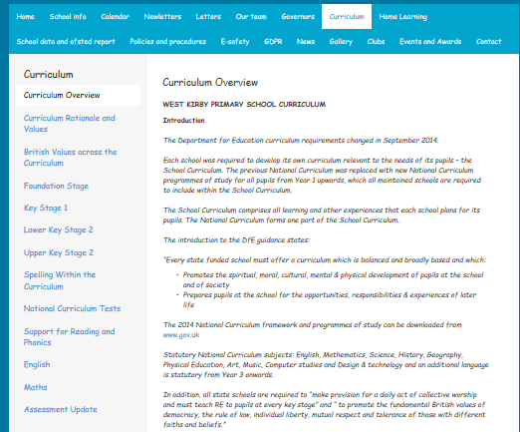
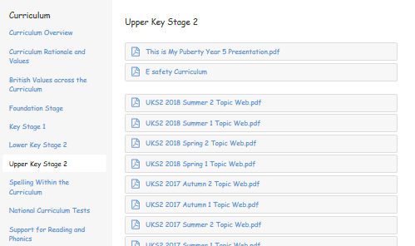
From here you can select your child’s key stage to download a copy of the current topic web.
Here you will also find other information about the structure of the curriculum here at West Kirby Primary School.

Slide 14
Topic Web
This also shows any planned school trips. Unfortunately, at the moment due to Government guidance and Covid-19 any trips are as yet to be confirmed. This includes the Y6 Residential to Anglesey and Bikeability, Beach Day and Water sports for Y5.

Slide 15
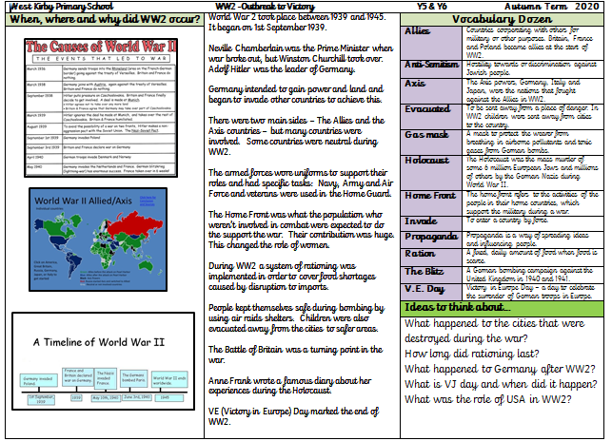
Upper Key Stage 2 Learning Mat, which the children will use in school.

Slide 16
UKS2 Topics 2020-2021
Autumn Term 1– World War 2
Autumn Term 2 – Romans & Anglo Saxons
Spring Term 1– Picts, Scots & Vikings
Spring Term 2 – Exploring Scandinavia
Summer Term 1– My Liverpool Home
Summer Term 2 – Why Choose Wirral?
English and different subjects are linked together to support the development of the children’s learning.
Computing is also used to develop the themes, but we also include teaching Internet Safety.

Slide 17
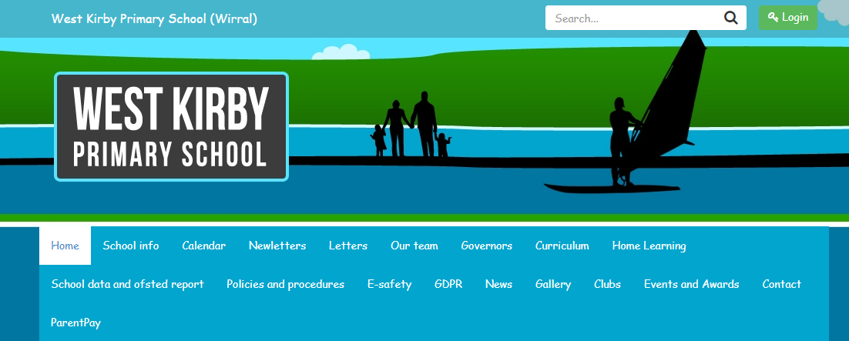
Navigating our Website
At the beginning of each half term, you can see a list of Home Learning tasks set. From the Home page click the ‘Home Learning’ tab

Slide 18
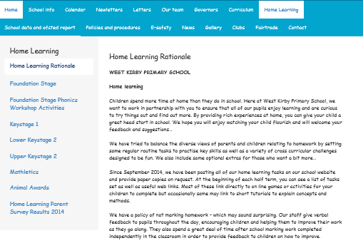
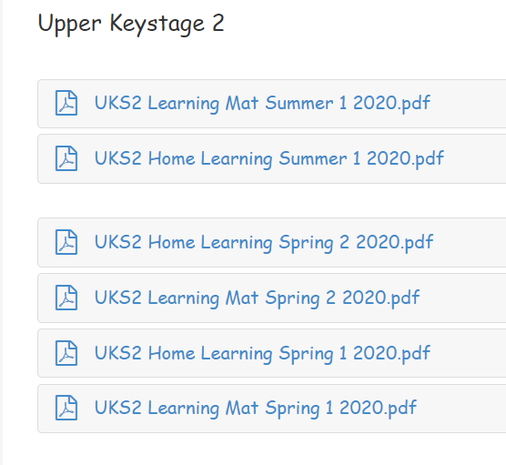
From here you can select your child’s key stage to download a copy of their Home Learning & current Learning Mat.
There are also links to Mathletics, Purple Mash, Animal Awards & Picture News

Slide 19
Why do we have Home Learning?
To reinforce learning, develop skills and increase self confidence/self esteem.
To give parents an opportunity to engage with their child’s learning, provide support and have realistic and ambitious expectations.
To encourage children to become independent learners for life.

Slide 20
We have tried to balance the diverse views of parents and children relating to homework by setting some regular routine tasks to practise key skills as well as a variety of cross curricular challenges designed to be fun.
We also include some optional extras for those who want a bit more…

Slide 21
The Structure of Home Learning at West Kirby Primary School

Slide 22
The first page gives important dates and information as well as showing which topic children are studying that half term.

Slide 23
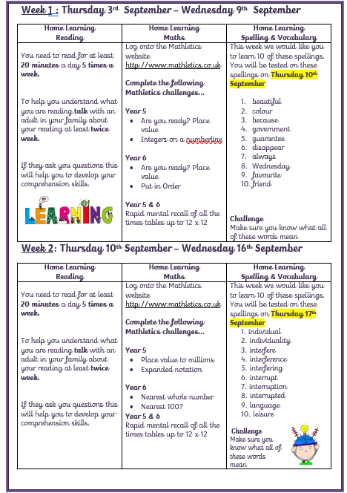
Next are the weekly reading, maths and spelling tasks to be completed together with a reminder of the home learning week and spelling test date.

Slide 24
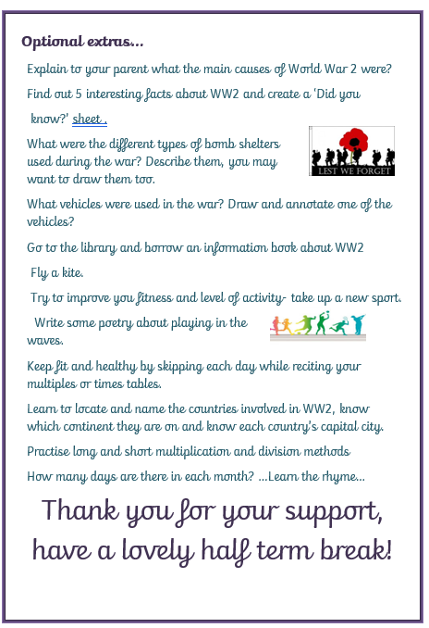
Finally, some suggested activities that you may want to complete with your child.

Slide 25
Reading at Home
In Upper Key Stage Two we would like children to read for 20 minutes per evening and talk to an adult about what they have read in order to promote their enjoyment and understanding.
Please encourage your child to read as wide a variety of books as possible – they need to hone their reading skills across a wide range of genres and text types.

Slide 26
Library Jane…
We are very lucky to have a part time qualified children’s librarian in our school.
Her role is to promote the love of reading and reading for pleasure throughout the whole school.
Jane helps to select, purchase and maintain stock that meets the needs of our children.

Slide 27
School Library…
Library clubs
Weekly library sessions
Book promotion
1:1 reading and reading groups
Track reading
Identify problems and reluctant readers
Encourage reading at greater depth
Purchase stock to suit readers
Fund raising for book stock – book fairs and sales
*There are some restrictions at the moment due to Covid-19
and classes operating in bubbles.

Slide 28
Maths at Home
The aims for using Mathletics
For the children to feel more confident with their Maths ability in solving calculations and working through problems.
To be able to consolidate their Maths strategies and identify any gaps in their learning.
To reinforce the topics covered in school.

Slide 29
Spelling at Home
Our spellings link with the requirements of the National Curriculum for KS2 is on our website.
Children are required to be able to spell words from the list of common exception words for their phase and all the phases below, and to be able to use their knowledge of spelling rules to add prefixes and suffixes to root words.
Under the Curriculum tab on our Home Page you will find a link to English, Maths, Reading and Spelling and further support in each of these areas.
Some tips for teaching spelling -Let them get creative, turn the word into a drawing.
Write words out by hand, perhaps 3 times each word.
Encourage reading through the spelling list and spell the word out loud.
Keep words on display- make flashcards.
Play games to practice spelling.

Slide 30
Red Book Bag and School Library Books
Red Book Bag should be returned to school every week on a Wednesday with your child’s library books and any Optional Extras they have completed.
Any comments or queries you have please email using our UKS2 email address
UKS2@westkirbyprimaryschool.co.uk
Also let us know if there were any problems that your child had with the Home Learning.

Slide 31
PE & Swimming
All children are expected to participate in PE lessons..Due to Covid-19, on the day when your child has PE (Friday) they will be required to attend school in their PE Kit , and remain in their kit for the whole day.They do not need to bring in a pump bag.
Our indoor PE Kit is a pale blue t-shirt, navy shorts and black pumps.
During outdoor PE lessons, and when the weather becomes colder we suggest your child wears dark leggings or joggers and a pair of trainers. They will need their school jumper/cardigan to wear over their blue PE t-shirt.
Due to Covid-19 we are unable to go swimming as planned in the autumn term, but hope to have more information as the year progresses.

Slide 32
Rewards and Sanctions
Children are awarded team points for good work, behaviour and displaying good manners or kindness to others.
These are totalled weekly and the team with the greatest amount of team points each term receive extra play time.
Throughout the school we follow the same behaviour management system so all children are familiar with it. Everyone starts the day in green zone. Children are asked to move their name below the line in green zone or to orange or red zones depending on the nature or severity of the sanction deemed necessary by their class teacher or any member of staff for any incident that is not in line with our Code of Conduct.
Children whose names move to orange or red miss some of their play time.
Children who stay in the Green Zone for the half term receive an extra play time, during which time those with orange and red cards reflect on their actions.

Slide 33
Rewards …
We will still be celebrating Star of the Week each Friday.
Every week, each class teacher choses a child to be the Star of the Week.
This would usually be celebrated in a whole school assembly on a Friday morning where children would be awarded their certificate.
Due to Covid-19, Star of the Week will now be done via Teams meetings across Key Stage Phases during the school day. An electronic copy of the certificate for the chosen child will be sent home by email.
Notes:
Kelly

Slide 34
Rewards …
House Teams -This year, we are introducing houses:
Birket
Arrowe
Dibbin
Fender
The four rivers are replacing the basic colours used for house recognition. By using local rivers are going to develop geographical knowledge of the Wirral.
Each child is allocated a river and they stay in that river as they pass up into another year group in school.
If a child has a brother and/or sister in another year group, then they will all be in the same House (river). There may not be the same number of children in each house, in each class, but there are roughly the same number of children in each house across the school.
Team points are recorded on the Rivers Team Point Chart. They will be added up with all the other Rivers Team Points from all classes across the school. You can get Team points for work, behaviour and anything positive that you do in school or bring in from home.
Notes:
Kelly

Slide 35
Our Bubble Rules
These are the Class Bubble Rules that we have already talked through with the children in each class bubble.

Slide 36
What if a Class Bubble needs to close?
If a Class Bubble needs to close, we will be using the school’s VLE (virtual learning environment) to share work with the pupils in the class. This is linked to our school website, and works in a very similar way to the way in which we put work for pupils on our website during lockdown.
Each child will be given their own log on for them to access their class area. They will bring this home with them tomorrow. Please keep it in a safe place. We hope that we do not have to use the remote learning plan that we have in place, but if we do, your child will need the log on to have access to their school work, to email in their work and to complete activities.
Everything that your child will need to join the rest of their class for remote learning will be on their class’ homepage on the VLE. They access the VLE through the school website using their log in details.

Slide 37
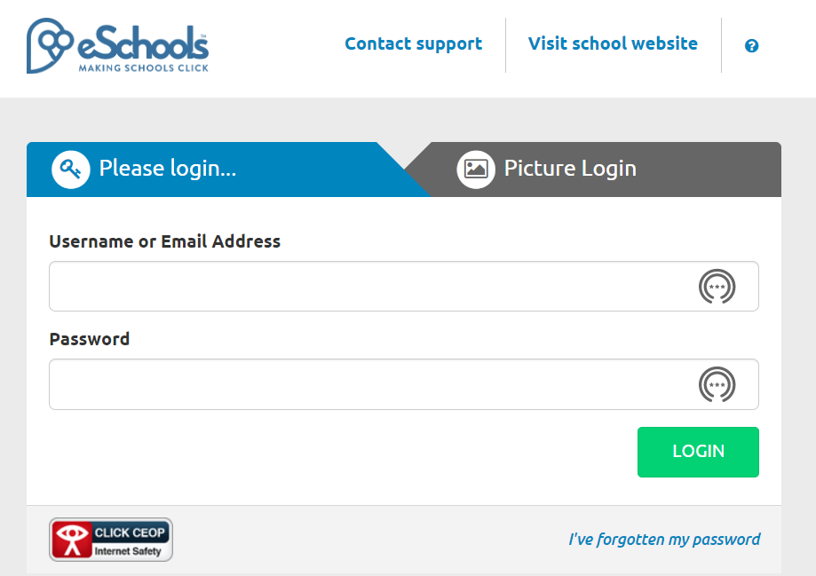
When they click to login, a new window opens up.
They then type in their user name and password.
There is an option for picture login for younger children.
They are then taken to their class Homepage, and from here can open up the work for the day.
The children will be shown how to do this in school too.

Slide 38
Keeping in Contact
Phone, text or email the school office
To contact UKS2 staff directly, use the queries email for our phase that we introduced during lockdown
UKS2@westkirbyprimaryschool.co.uk
Use either method to arrange a meeting.

Slide 39
Thank you taking the time to read through the information in this PowerPoint and for supporting the Upper KS2 teaching team at
West Kirby Primary School.
We really hope that your child enjoys their time in UKS2 and that they really achieve their best in class.

