Slide 1
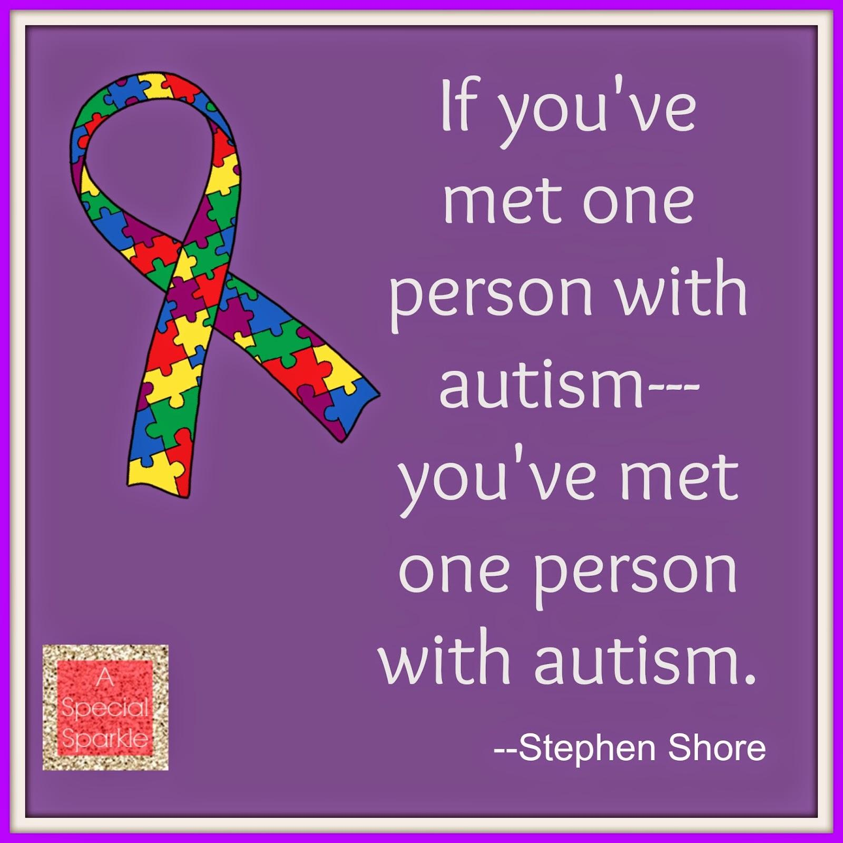
Celebrating Differences
Autism

Slide 2
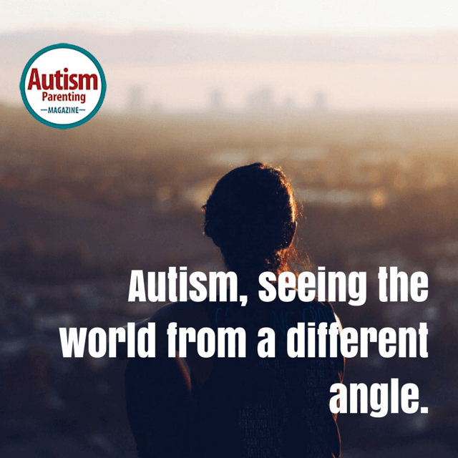
What is Autism?
What do you already know?
Watch this short clip…… Amazing things can happen
Seeing autism through an autistic person's eyes…..
Can you make it to the end?

Slide 3
What is Autism?
Autism is a lifelong developmental disability that affects how people perceive the world and interact with others.
Autistic people see, hear and feel the world differently to other people.
If you are autistic, you are autistic for life; autism is not an illness or disease and cannot be 'cured'.
Often people feel being autistic is a fundamental aspect of their identity.
Autism is a spectrum condition.
All autistic people share certain difficulties, but being autistic will affect them in different ways. Some autistic people also have learning disabilities, mental health issues or other conditions, meaning people need different levels of support. All people on the autism spectrum learn and develop.
With the right sort of support, all can be helped to live a more fulfilling life of their own choosing.

Slide 4
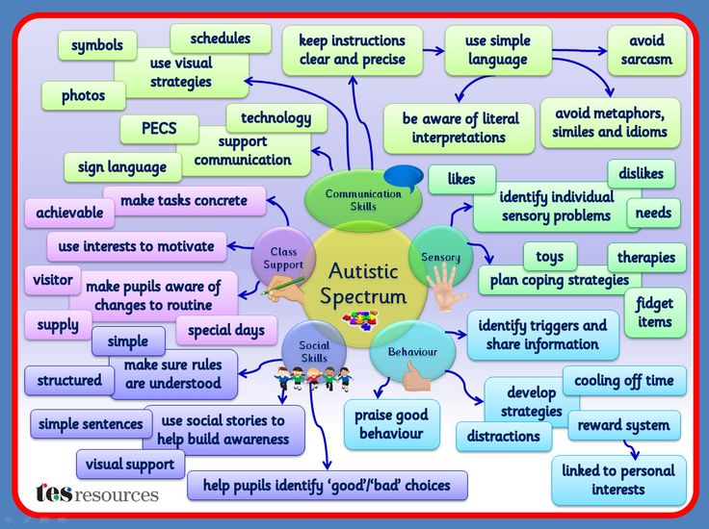
Autism is a spectrum disorder………...

Slide 5
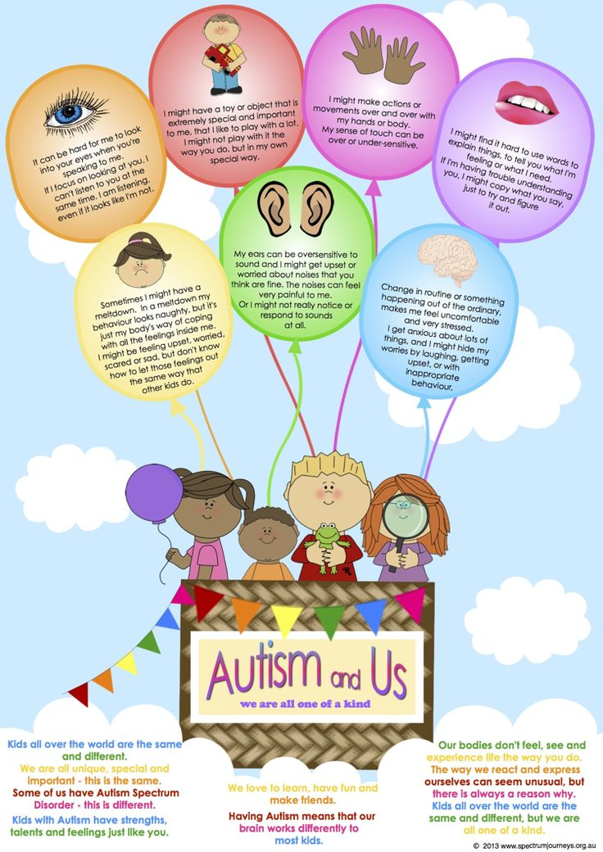
What people with autism would like you to know...

Slide 6
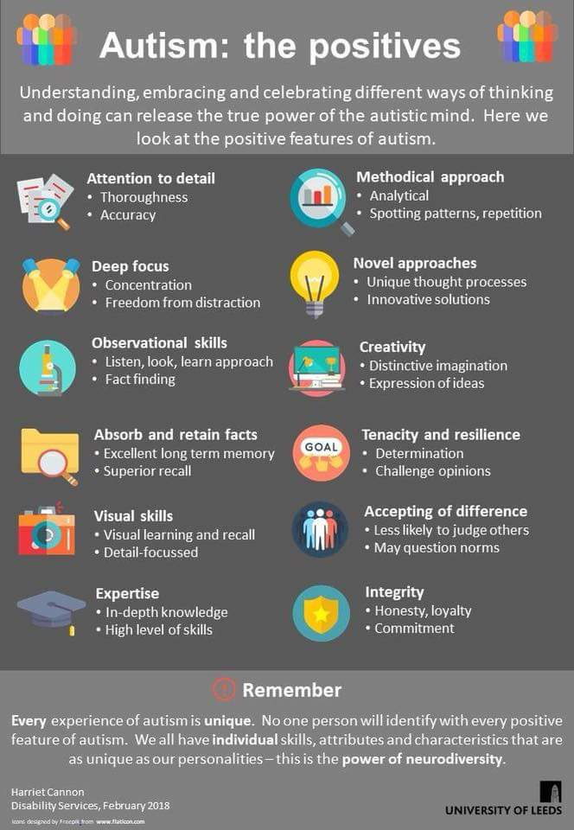

Slide 7
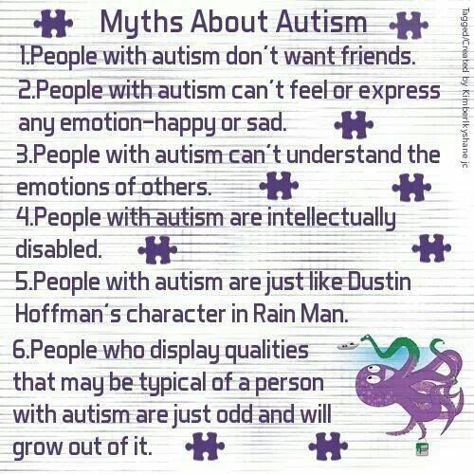
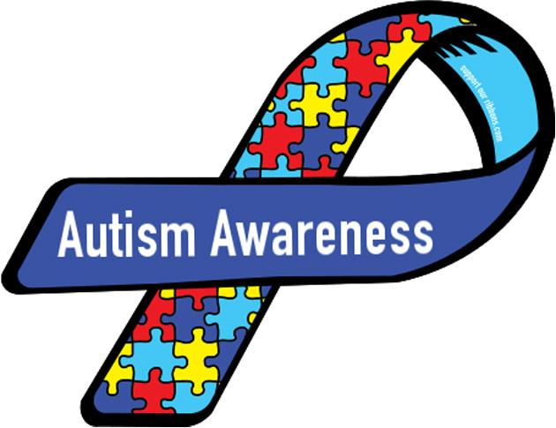
Famous people with Autism...
Autism - famous people

Slide 8
