Slide 1
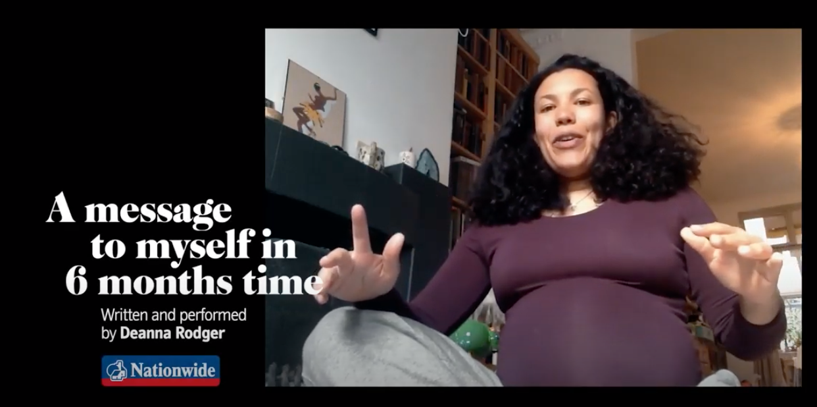
Expanded Noun Phrases
What is a noun phrase?
How can you build one? What type of words can be used?
How can you identify a noun phrase?

Slide 2
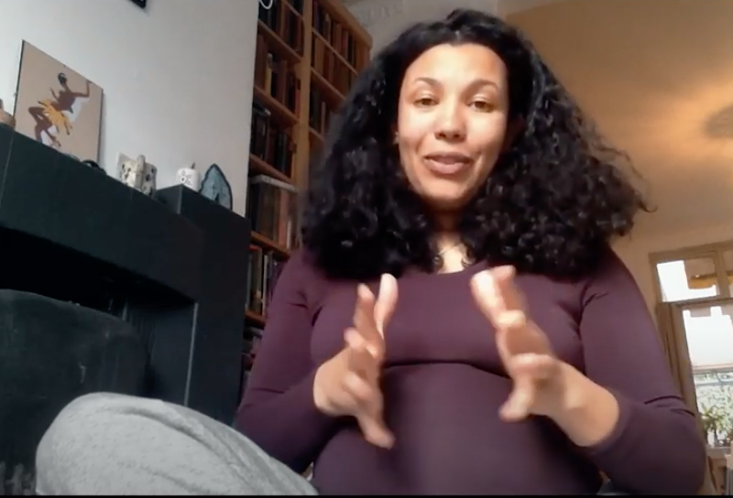
Nouns
A noun names a person, place, idea, thing or feeling.
Adjectives
An adjective is a describing word.
It tells you more about a noun.
noun phrases
a garden
the unity
an idea
cookies
a concrete garden
the wonderful unity
a powerful idea
home-made cookies
In front of a noun, we often have
a an the
A noun phrase adds extra detail to the head noun.
determiners

Slide 3
Adverbs
An adverb can modify adjectives.
Adjectives
An adjective is a describing word.
It tells you more about a noun.
noun phrases
noun phrases
a completely concrete garden
the utterly wonderful unity
a very powerful idea
lovingly home-made cookies
a concrete garden
the wonderful unity
a powerful idea
home-made cookies
In front of a noun, we often have
a an the
A noun phrase adds extra detail to the head noun.
determiners

Slide 4
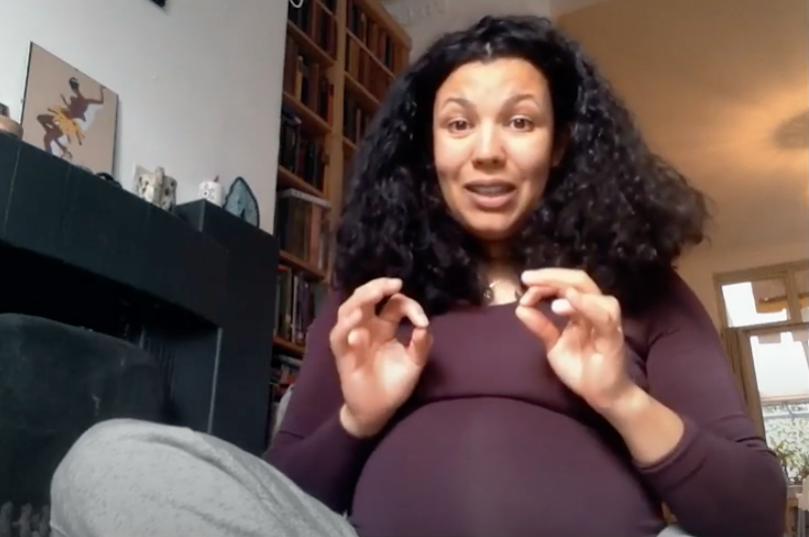
These noun phrases include nouns, adjectives, adverbs and determiners.
noun phrases
We can test a noun phrase by seeing if it can be replaced by a pronoun.
a completely concrete garden
the utterly wonderful unity
a very powerful idea
lovingly home-made cookies
She knew that the utterly wonderful unity was real.
A noun phrase adds extra detail to the head noun.
She knew that it was real.

Slide 5
Expanded Noun Phrases
You can develop an expanded noun phrase by adding a prepositional phrase.
the home-made cookies
the home-made cookies in the biscuit tin
the home-made cookies with chocolate chips
the home-made cookies from next-door
The prepositional phrase modifies the noun…
Prepositions
with, of, by, from, on, under, below, between, inside, next to, over, by, in
and expands the image of the noun.

Slide 6
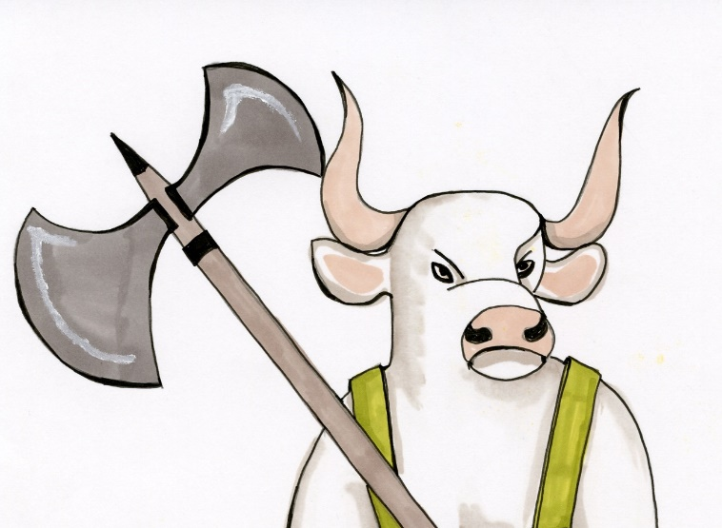
Can you spot the head nouns? The noun the phrase is built around
Can you spot the noun phrases? The words which work together to expand on the noun
It was the weird bellowing noise which first alerted Percy.
it
It swung rather huge meaty hands like rocks as it ran.
them
A dark silhouette in the storm was following them.
it
them
It had two deadly, sharp horns and it was getting closer.
it
Percy recognised the creature’s very furious face with rolling eyes at the window.
To test which words make up the expanded noun phrase, use the pronoun test.
ANSWERS

Slide 7
So how can we use this knowledge?
- to help us create impactful images.
wings
eyes
teeth
claws
smile
Try building some expanded noun phrases around some of these nouns.

Slide 8
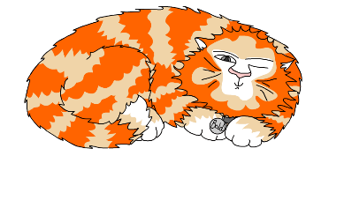
Explore more Hamilton Trust Learning Materials at https://wrht.org.uk/hamilton/ .

