Slide 1
Daily Calming activities

Slide 2
Why
A growing number of studies show that breathing techniques are effective against anxiety and insomnia.
These techniques influence both physiological factors (by stimulating the parasympathetic nervous system) and psychological factors (by diverting attention from thoughts).
Research shows that negative emotions affect learning, memory and behaviour. Positive emotions have a positive impact.
It helps achieve our school vision: happy children with the skills necessary for now and the future. Emotional regulation and managing our mental health are invaluable life skills.

Slide 3
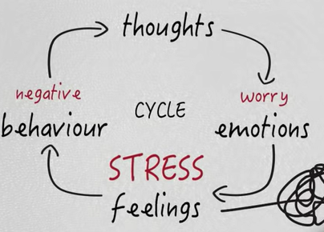
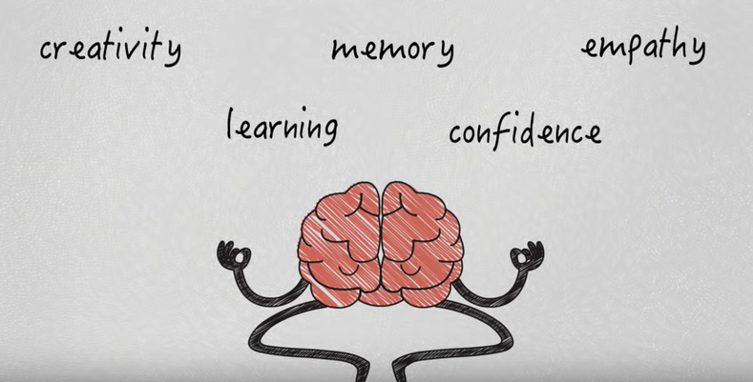
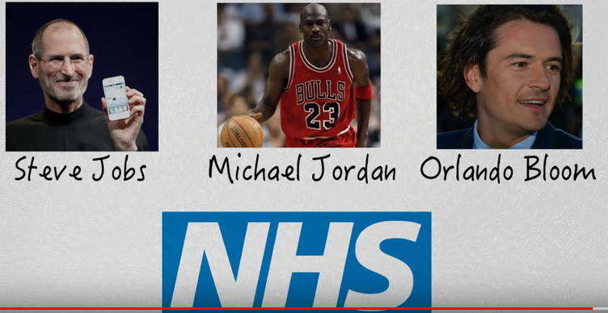
Additional Information - only if you’re interested.
When you are feeling calm and safe, at rest, or engaged in a pleasant social exchange, your breathing slows and deepens. You are under the influence of the parasympathetic nervous system (also known as ‘rest and digest’ ((I teach our pupils this name, but also refer to it as chill mode) which produces a relaxing effect.
Conversely, when you are feeling frightened, in pain, or tense and uncomfortable, your breathing speeds up and becomes shallower. The sympathetic nervous system, which is responsible for the body’s various reactions to stress, is now activated. Less well known is that the effects also occur in the opposite direction: the state of the body affects emotions. Studies show that when your face smiles, your brain reacts in kind—you experience more pleasant emotions. Breathing, in particular, has a special power over the mind. This is all due to the vagus nerve, which informs the mind what the body’s present experience is. This is why it is easy to get trapped in ‘moods’ / negative thinking cycles and why rapid breathing can contribute to and exacerbates panic attacks through a vicious circle: fear triggers faster breathing, which increases fear… The body reacts to thoughts and the mind reacts to the body.
Breath work is not magic (although it can appear to be), it simply aims to slow and deepen breathing and becomes a focal point to distract attention from the train of thoughts.
This video is well worth a watch as a starting point for thinking about the benefits of a stillness / breathing practice.
https://www.youtube.com/watch?v=VTA0j8FfCvs

Slide 4
What it will look like
Each day, children take part in one of these activities, for a brief time (ideally straight after lunch or first thing in the morning OR BOTH).
Pupils will come to know the activities and as they become a habit, will do them easily and independently.
When pupils are comfortable doing these activities independently, the consistency across school will help staff when dealing with distressed pupils (school resistance in the morning, friendship issues, anxiety, panic, serious injuries) or as a behaviour management strategy.
Pupils should be encouraged to have good posture to allow the respiratory muscles to work better.
Breathing through the nose (where possible) should be encouraged. Many people are more comfortable with ‘in through the nose, out through the mouth.’
The focus should be on the sensations of the breath: movement of the body as we breathe and the more subtle feelings around the nose and throat.

Slide 5
The Activities

Slide 6
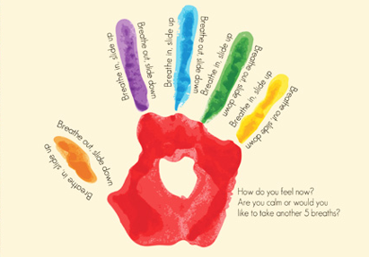
Monday
Take 5 Breathing
Some people prefer to close their eyes to help them focus more on the feelings of their breath and their finger.

Slide 7
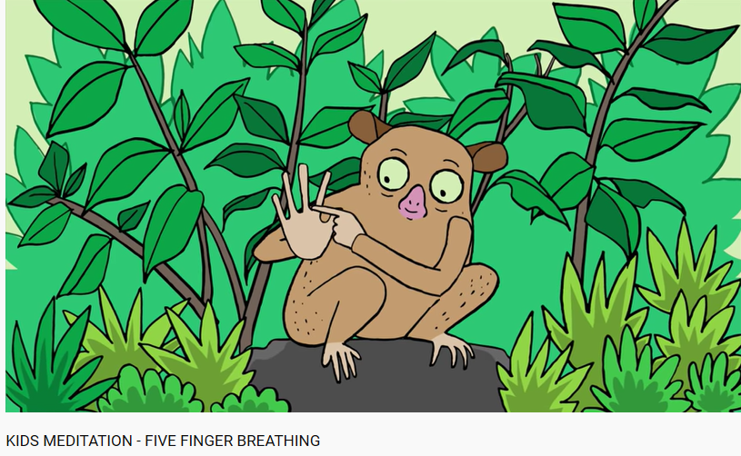
Take 5 Breathing – Click the image for a Guided version (Foundation Stage)

Slide 8
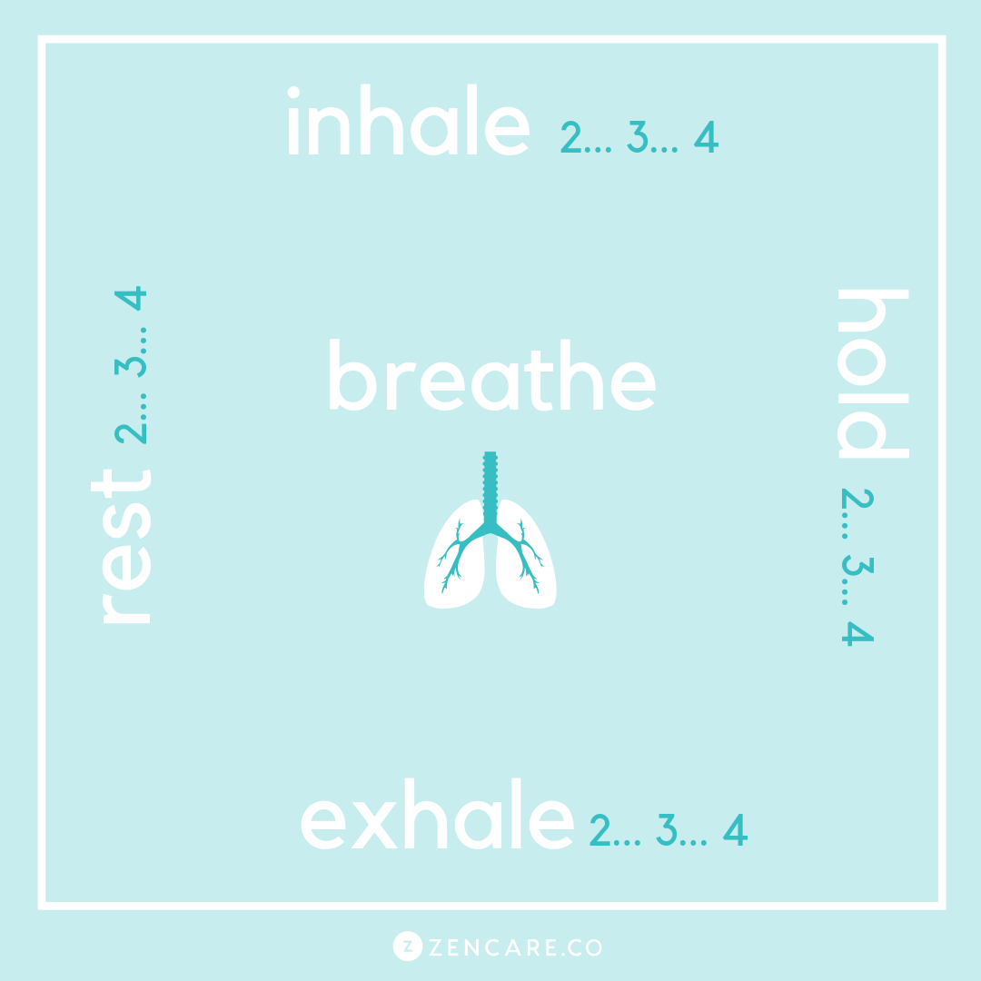
Square breathing is also referred to as box breathing, 4×4 breathing and 4-part breath.
Sit up straight to allow your body to breathe freely.
(Begin by slowly exhaling all of your air out, so it is easy to breathe in for 4 seconds.)
Then, gently inhale through your nose to a slow count of 4.
Hold at the top of the breath for a count of 4.
Then gently exhale through your mouth for a count of 4.
At the bottom of the breath, pause and hold for the count of 4.
Tuesday
Square Breathing
Some people prefer to close their eyes to help them focus more on the feelings of their breath.

Slide 9
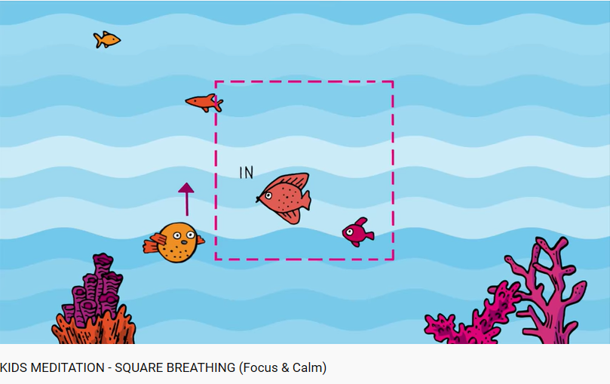
Square Breathing – Click the image for a Guided version (Foundation Stage / KS1)

Slide 10
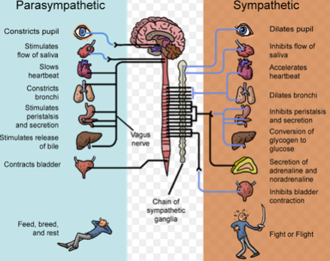
Chill mode breathing switches us quickly away from ‘go, go, go mode’. It is also referred to as 5:3 breathing or parasympathetic breathing.
Sit up straight to allow your body to breathe freely.
We want to breathe out for longer than we breathe in.
Try breathing out for 5 seconds and in for 3 seconds.
If this feels strained, try out for 4, in for 2.
The amount of time is not important as long as the exhale is longer than the inhale.
Wednesday
Chill Mode Breathing
Some people prefer to close their eyes to help them focus more on the feelings of their breath.

Slide 11
https://www.youtube.com/watch?v=wGFog-OuFDM
Mindfulness bell –
Mindfulness is simple: Paying attention to the present moment. We can pay attention to any of our senses, to our thoughts or to the sensations in our body.
In this activity, we are going to focus on sound – what we can hear. Listen closely to the sound of the bell. If you find yourself paying attention to something else, bring your attention back to the bell.
Thursday
Mindfulness Bell
Remember to breathe well:
Back straight, in through the nose, belly doing most of the movement.
Some people prefer to close their eyes to help them focus more on the sound.

Slide 12
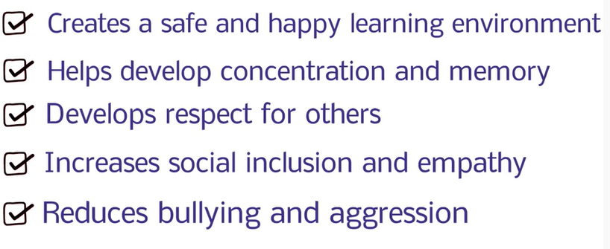
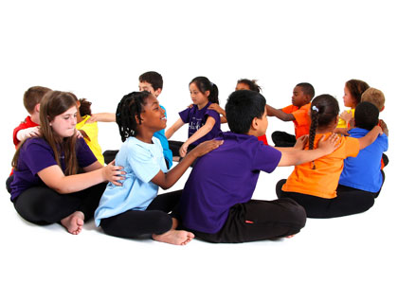
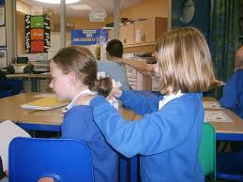
Partner A sit sideways on your chair, so your back is facing Partner B.
Partner B, always ask your partner if they would like a massage before starting. If your partner does not want a massage, they can just enjoy some quiet time.
Follow the actions in the video carefully.
Partner A, give your partner feedback. Ask them to stop, or to be more gentle if that’s what you want.
Friday
Peer massage
https://www.youtube.com/watch?v=h3GKQmYRHMU Grass Hopper Massage
3 mins

Slide 13
Extras – 1 min
https://www.youtube.com/watch?v=ZME0JKiweL4 Focus fully on the sound of the bell. Open your eyes when you can’t hear it anymore.
Extras – 2 mins
https://www.youtube.com/watch?time_continue=24&v=5LhCwHy6q20&feature=emb_title
Focus on the moving of the shape. Breathe in as it expands, breathe out as it shrinks.
Extras – 3 mins
https://www.youtube.com/watch?v=SEfs5TJZ6Nk
Guided mindful breathing.

