Slide 1
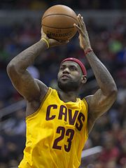
Basketball PE Challenge KS2
Make up a game that will help other people to improve bouncing the ball.
How many times can you dribble 5 metres and back in one minute?
How did it make you feel when you completed the challenge?
Develop
Make up a game that will help other people to improve bouncing the ball.
What are the Rules of your game?
How does it help you improve?
Is you game competitive?
LeBron James plays professional basketball in the NBA in America.
Can you find out 5 facts about LeBron James?
Explore
Find any ball that bounces. How many different ways can you bounce the ball standing still?
Bright ideas:
Walk with the ball and bounce it with one hand and then try with the other hand.
Jog with the ball and bounce it with one hand and then the other.
Bounce the ball between your legs from one hand to the other.

